Slide 1
An NSS Audio-Visual
Library Presentation
Organ Cave, WV
S739 81 Slides 2/08/2021

Slide 2
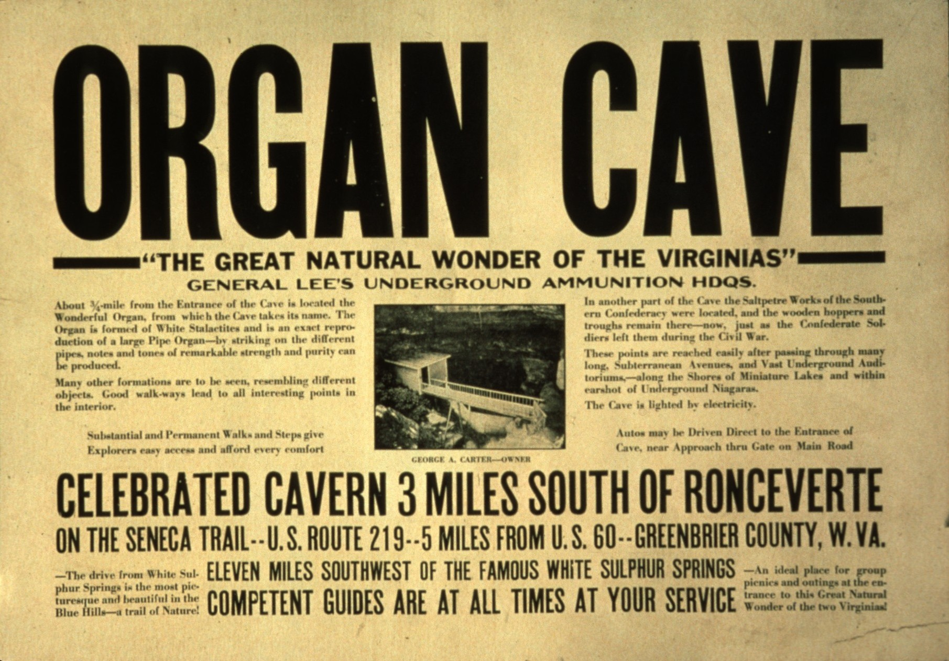
Notes:
The Organ Cave System is located ...

Slide 3
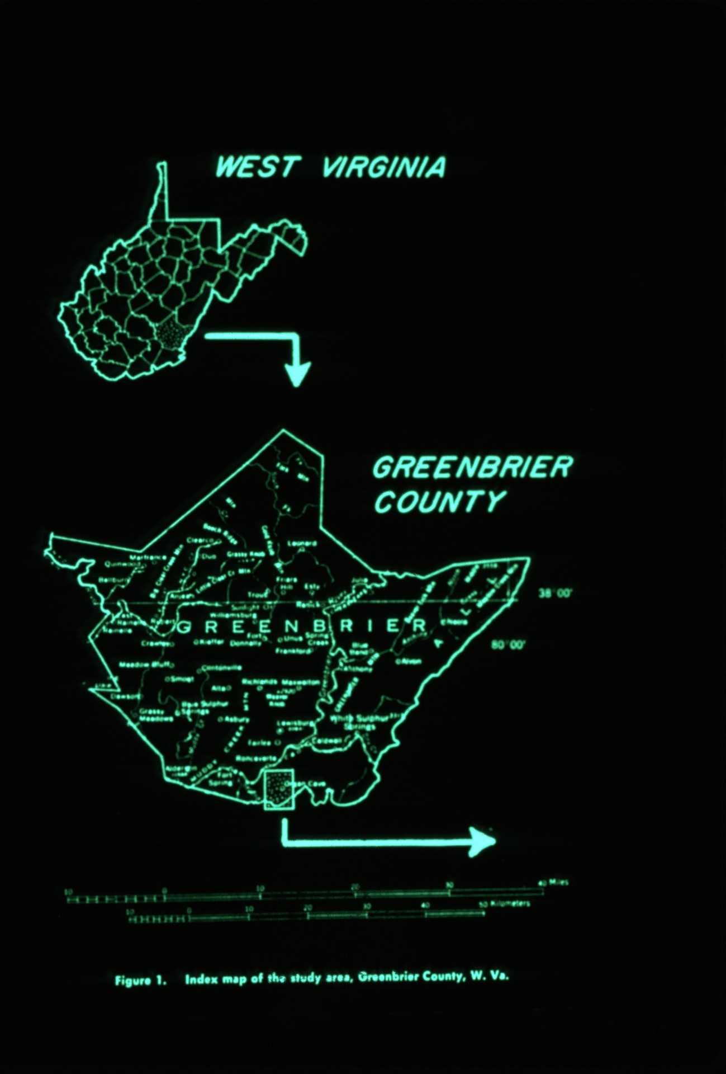
Notes:
at the southern end of Greenbrier County, West Virginia under the community of Organ Cave.

Slide 4
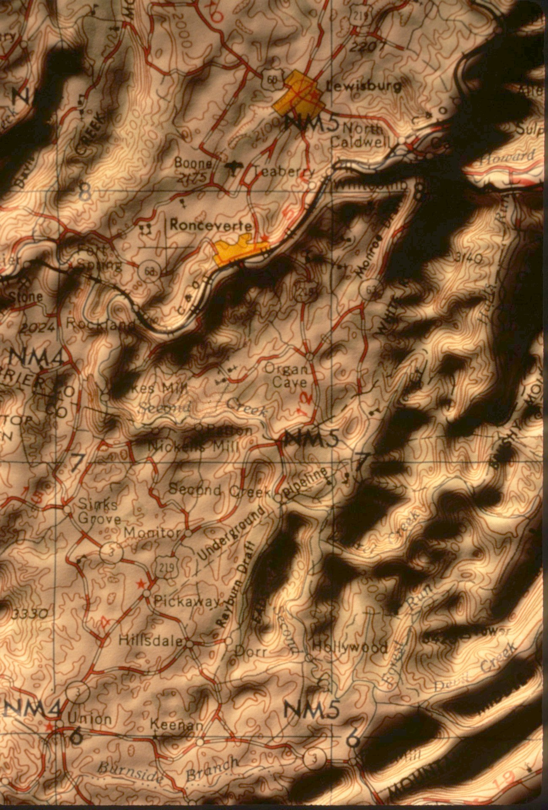
Notes:
It is developed in an erosional plateau that covers an area of approximately twenty-six square miles and has a relief of between 400 and 700 feet. It is bounded on the north and west by the Greenbrier River and on the south by Second Creek.

Slide 5
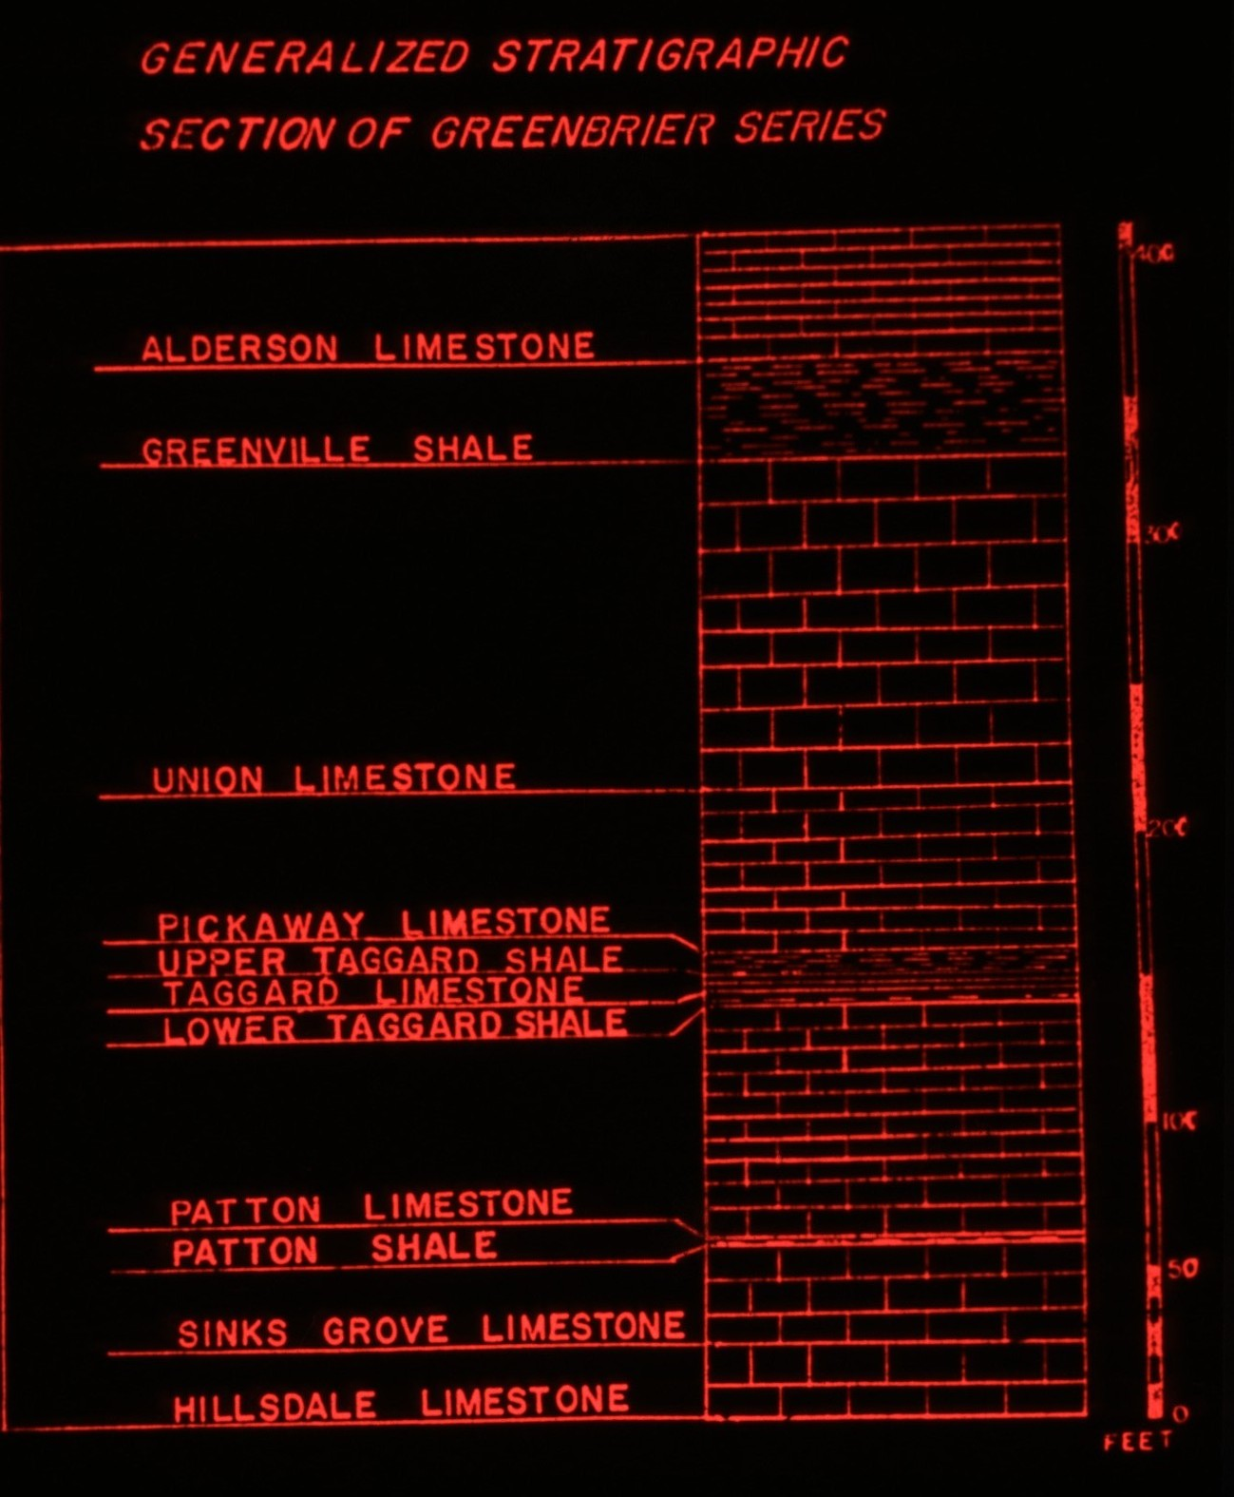
Notes:
The Organ Cave Plateau is capped by the Hillsdale and Sinks Grove limestones of the Middle Mississippian Group which are approximately 200 feet in thickness at Organ Cave. These limestones lie stratigraphically on the clastic red sandstones and shale sequences of the Maccrady and Pocono Formations which outcrop on the eastern surface of the plateau and along its north and west escarpments.

Slide 6
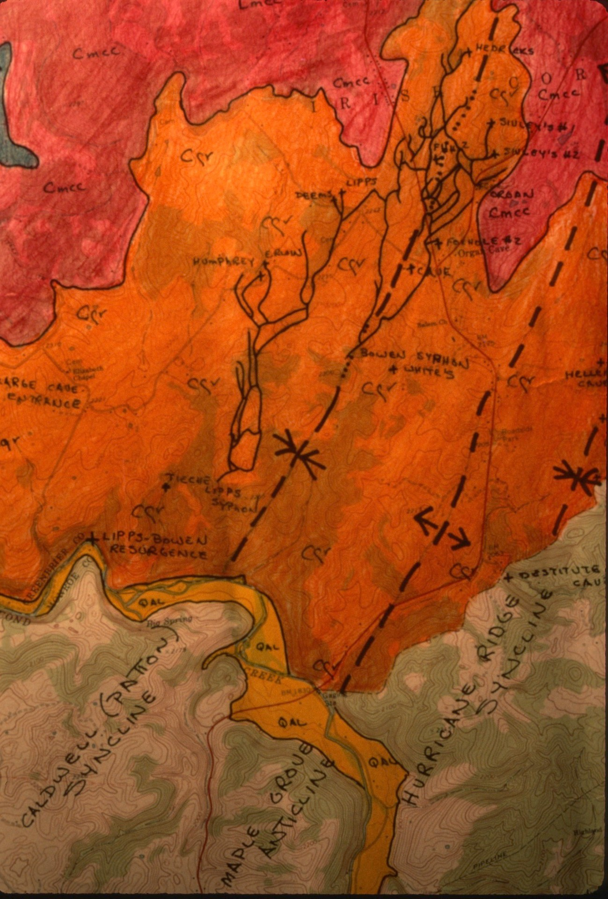
Notes:
The Organ Cave Plateau is located near the eastern edge of the Dissected Plateau Physiographic Providence. Structurally, the plateau consists of gentle anticlines and synclines that are the after-effect of the forces that formed the Valley and Ridge Physiographic Providence which is only nine miles to the east.

Slide 7
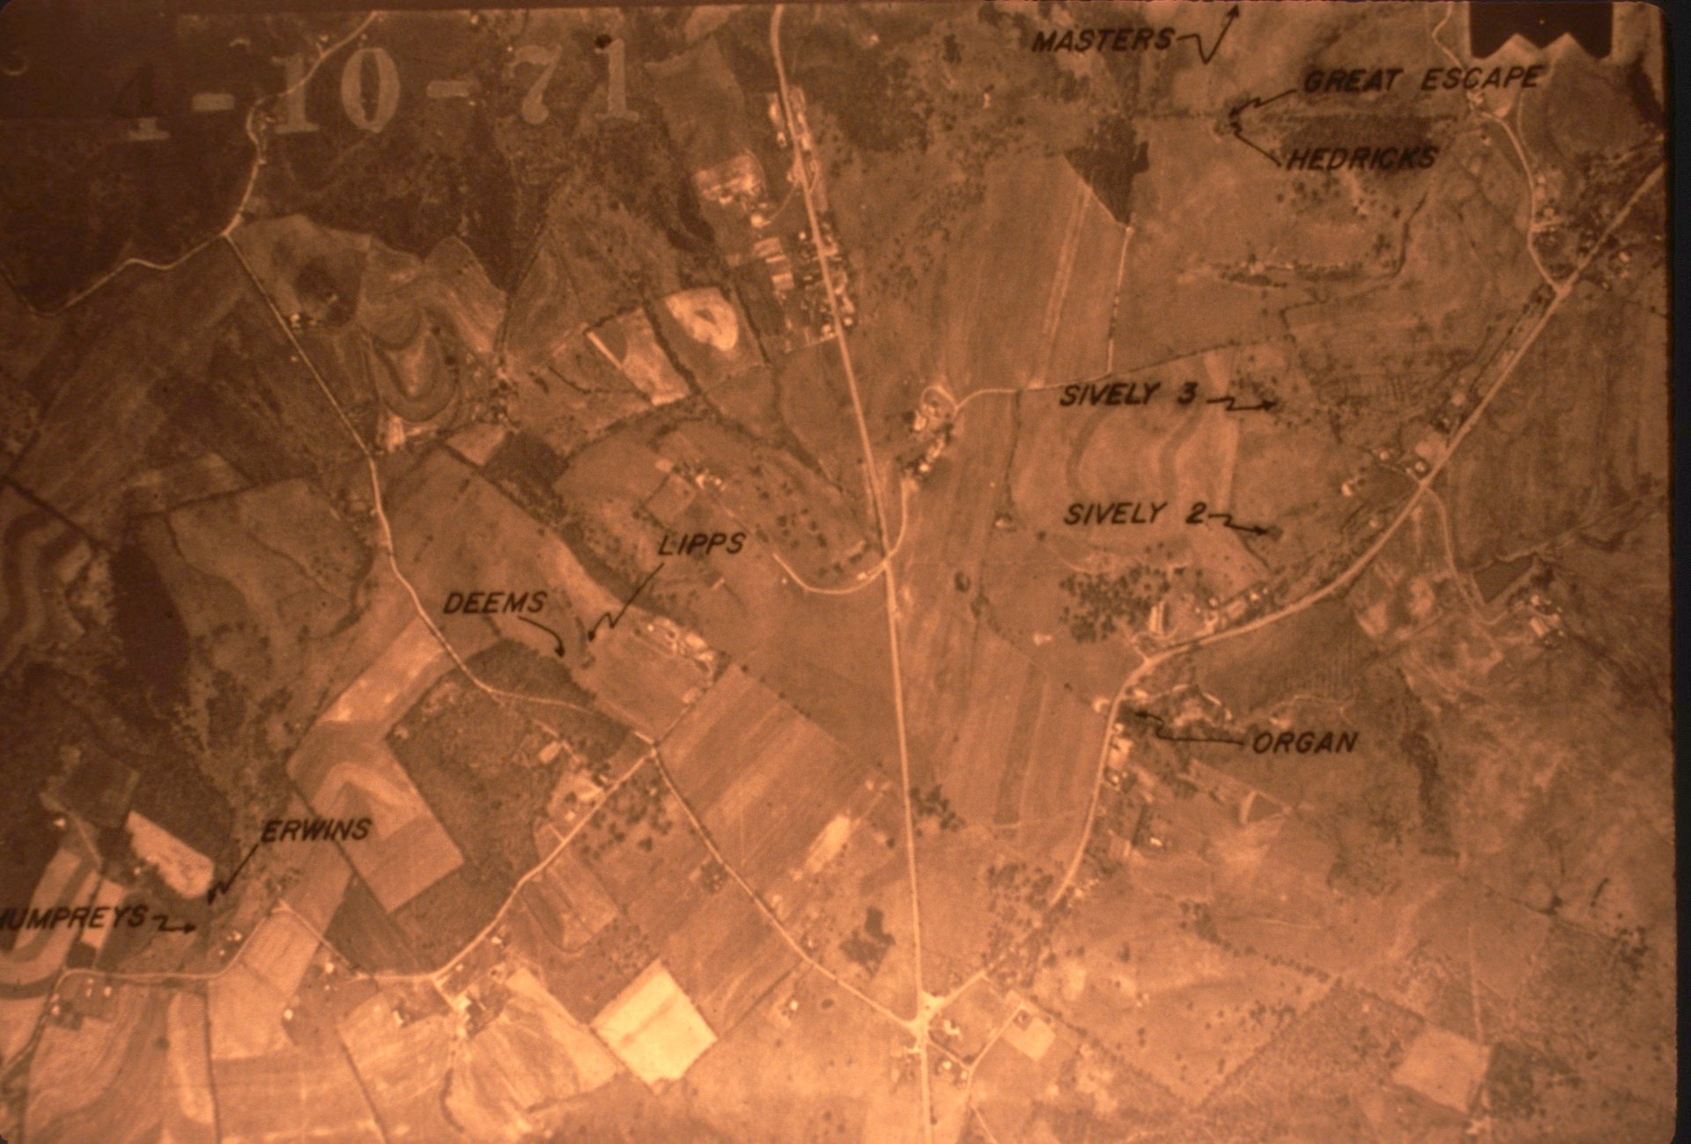
Notes:
To date, ten entrances to the system have been discovered:

Slide 8
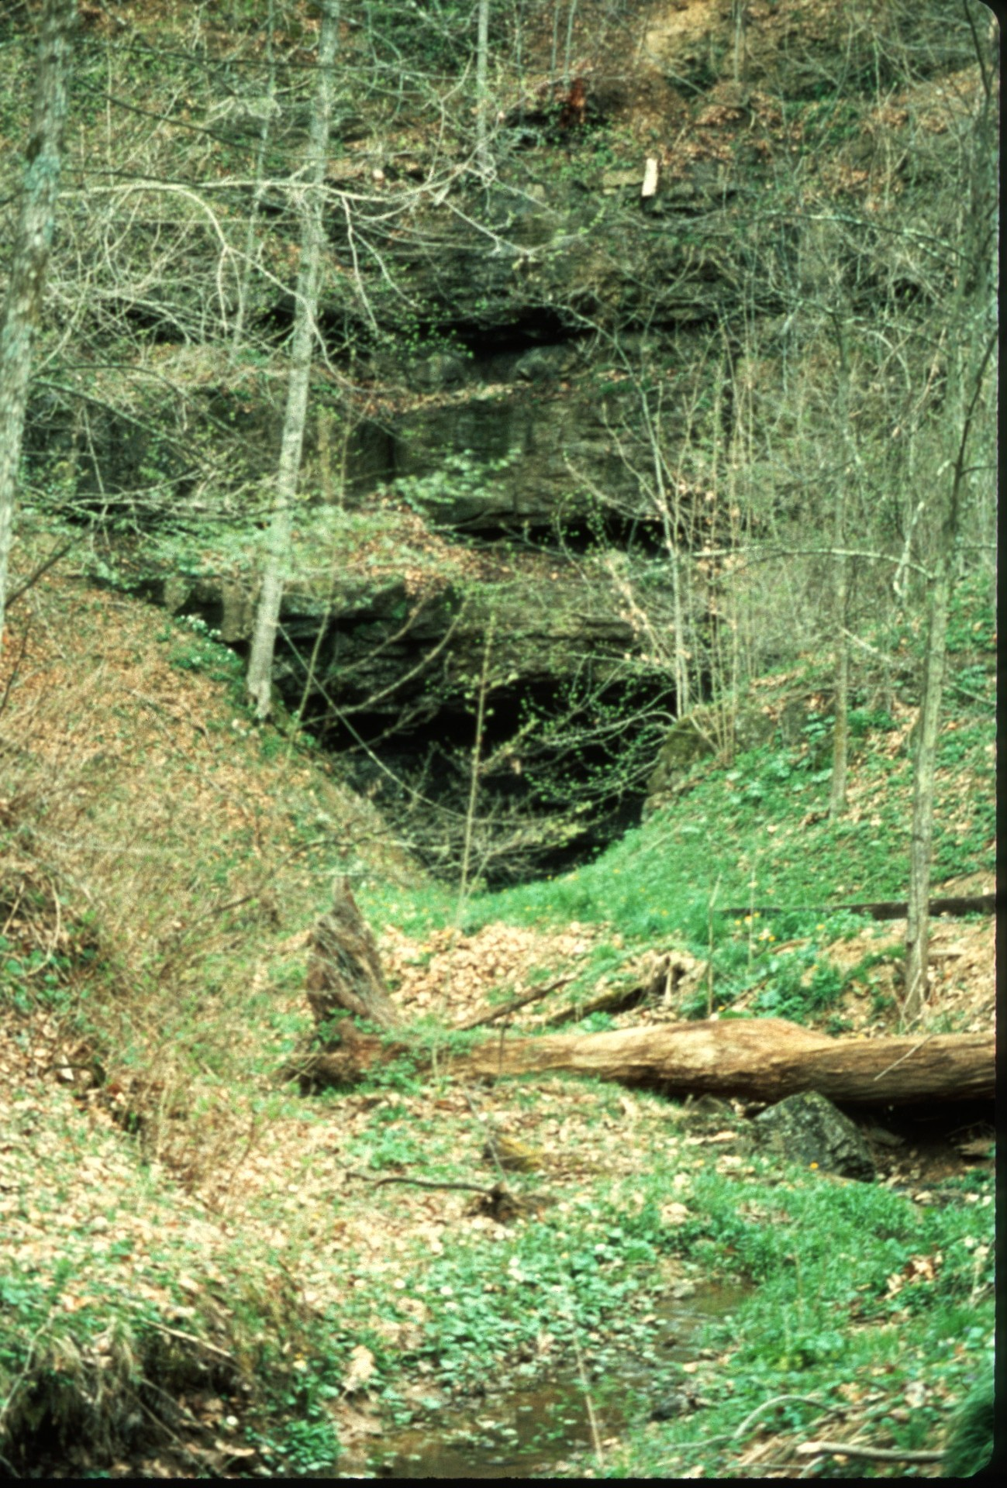
Notes:
Organ Cave Entrance

Slide 9
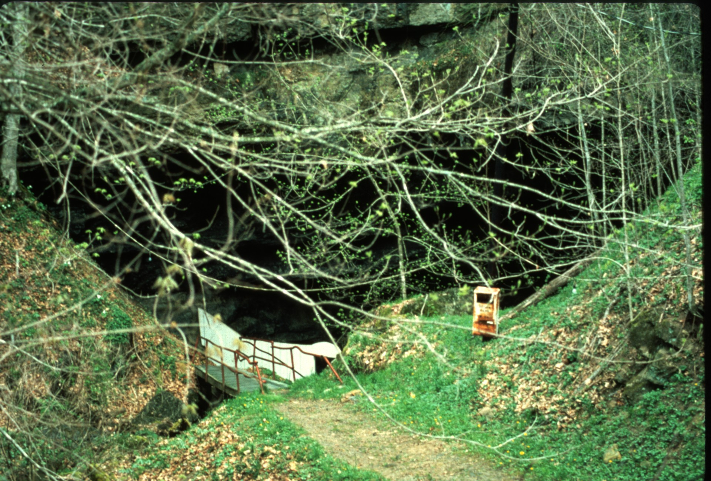
Notes:
Organ Cave Entrance

Slide 10
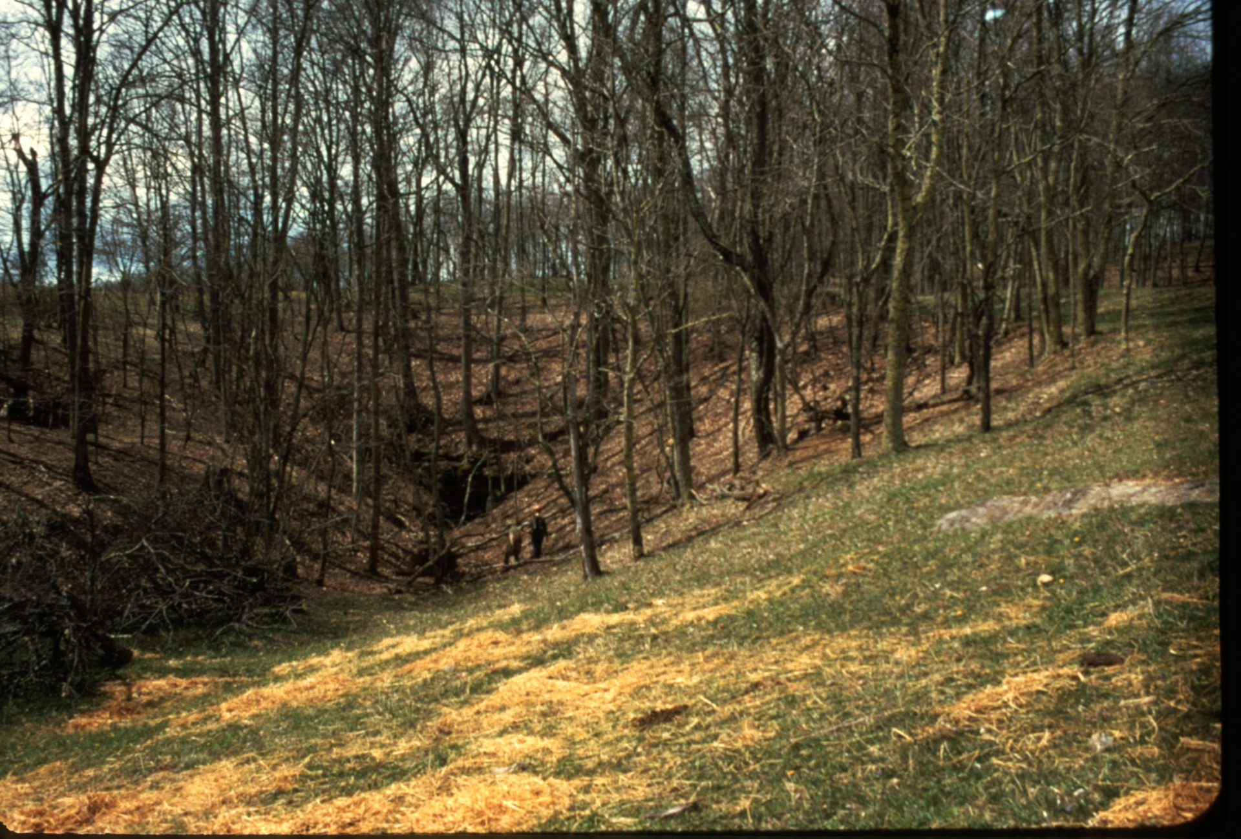
Notes:
Masters, closed since 1980

Slide 11
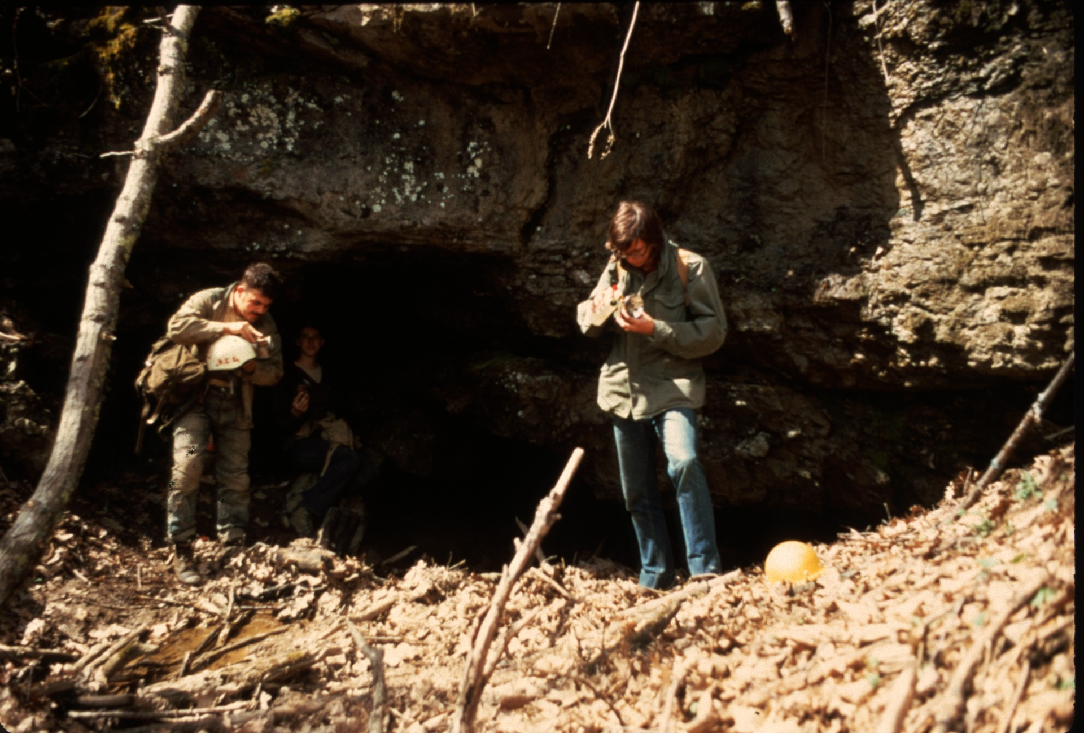
Notes:
Masters, closed since 1980

Slide 12
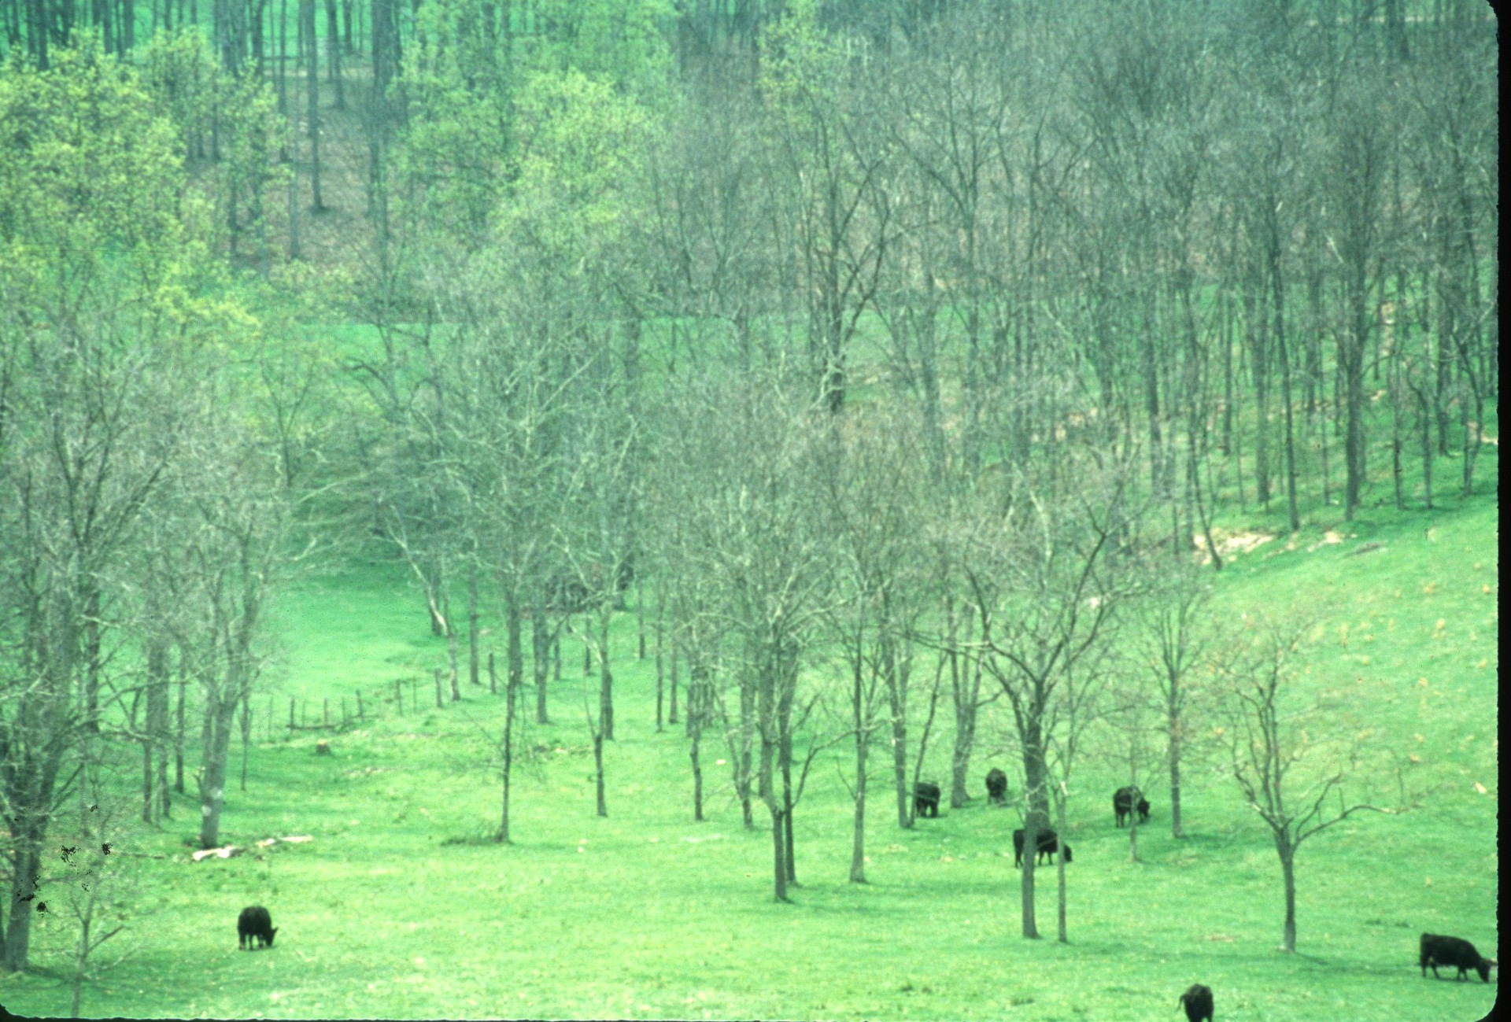
Notes:
Hedricks and Great Escape in the low point of this valley. They have been closed since 1960.

Slide 13
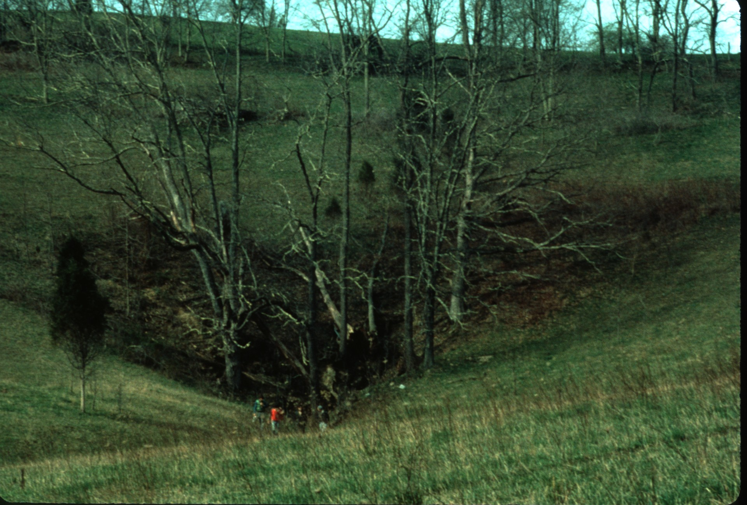
Notes:
Sively #2

Slide 14
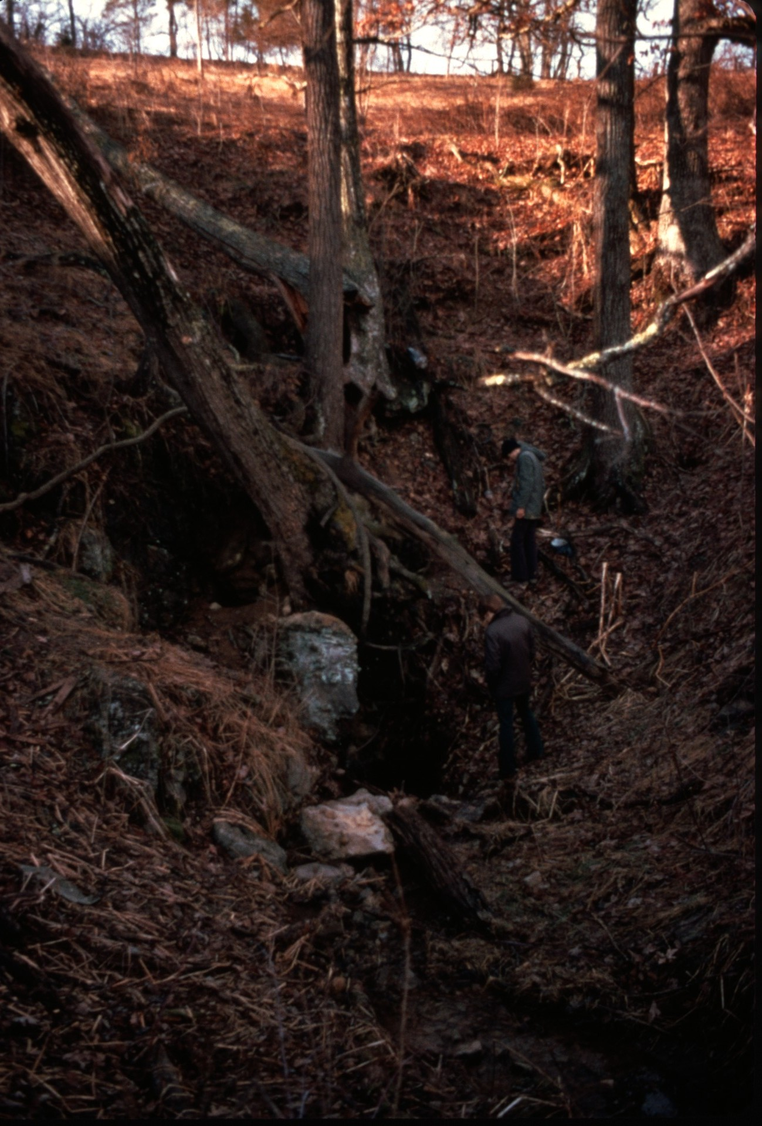
Notes:
Sively #2

Slide 15
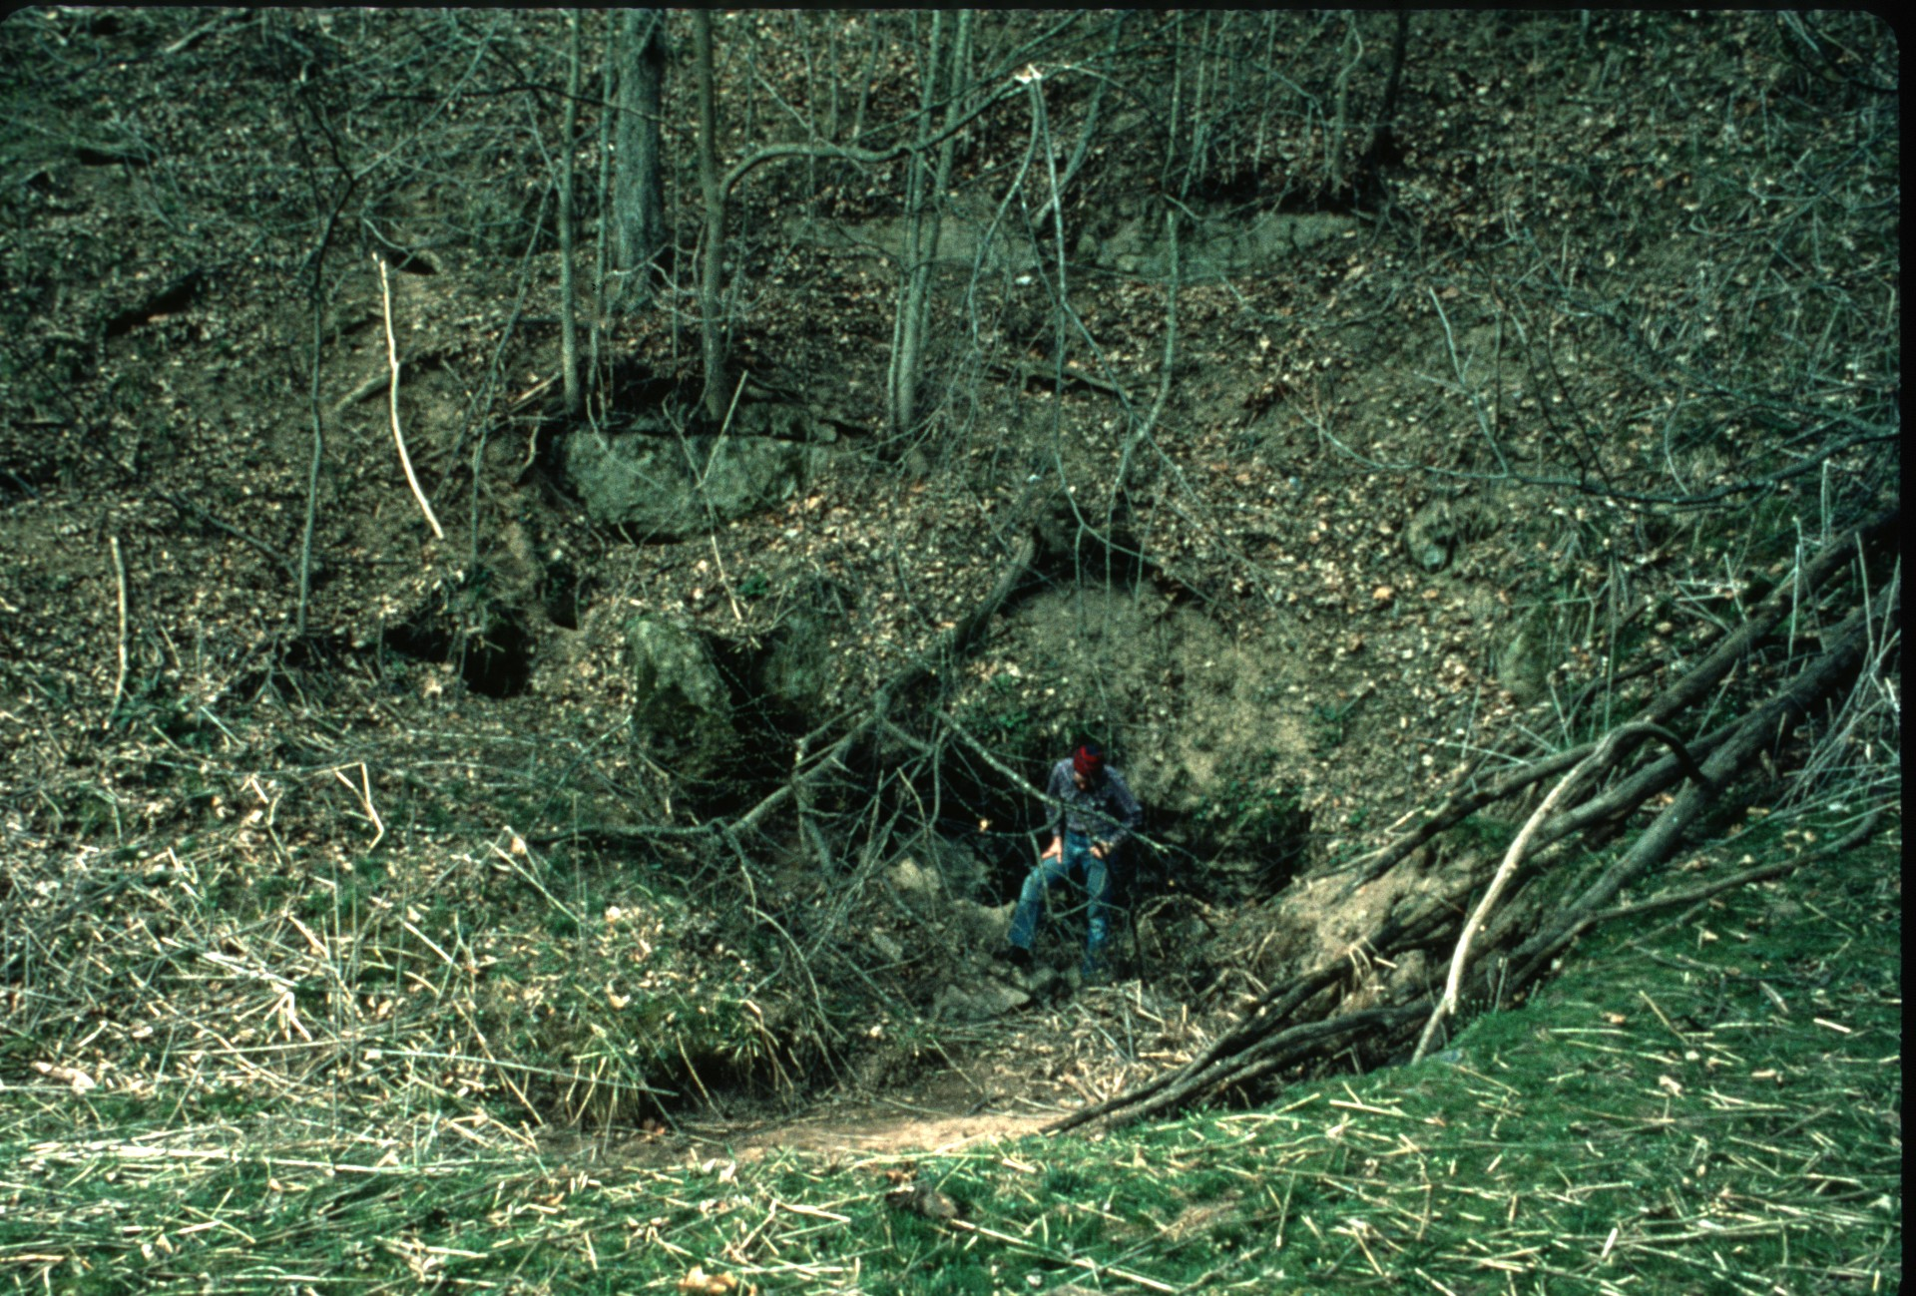
Notes:
Sively #3

Slide 16
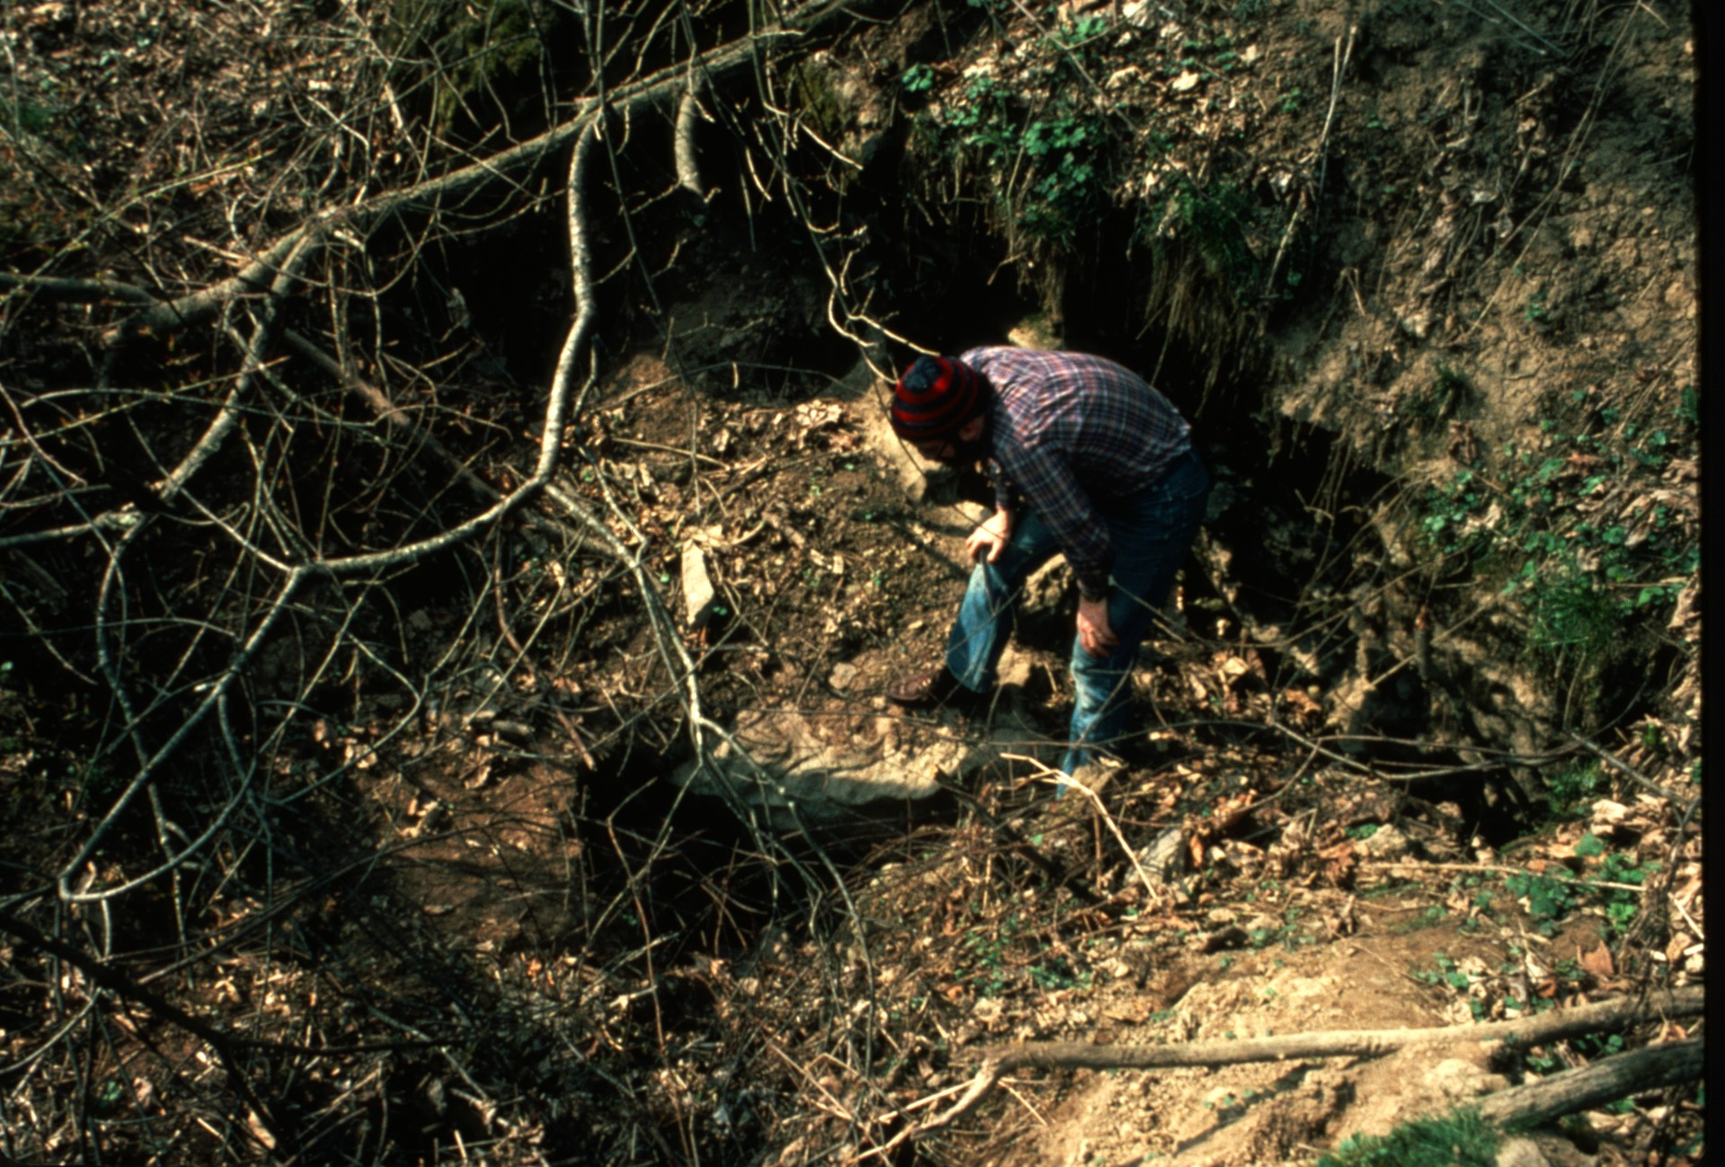
Notes:
Sively #3

Slide 17
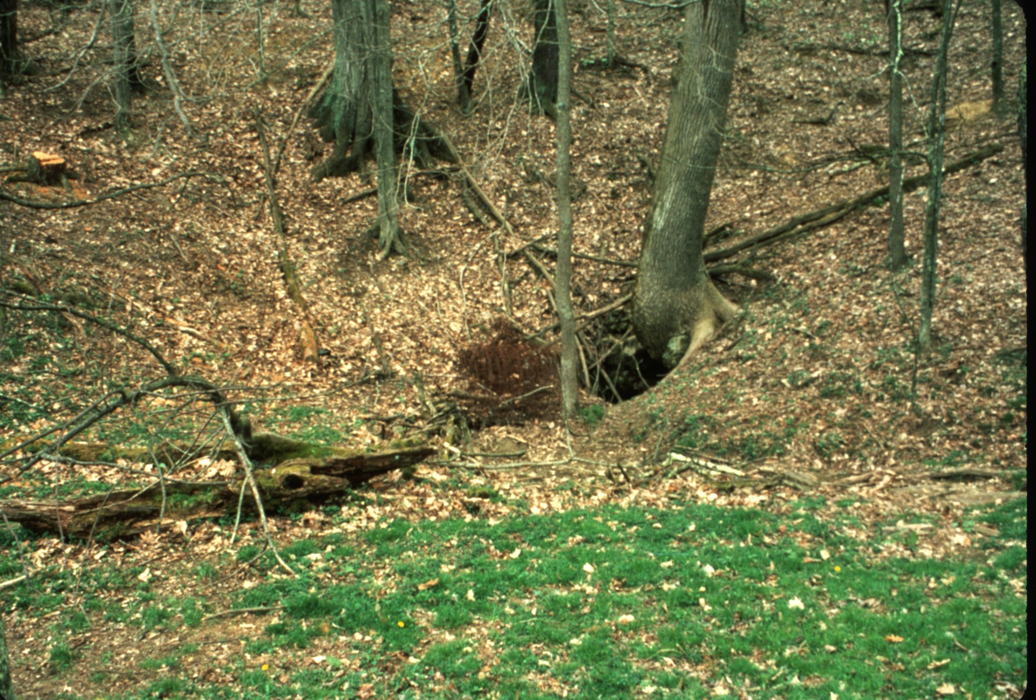
Notes:
Deems

Slide 18
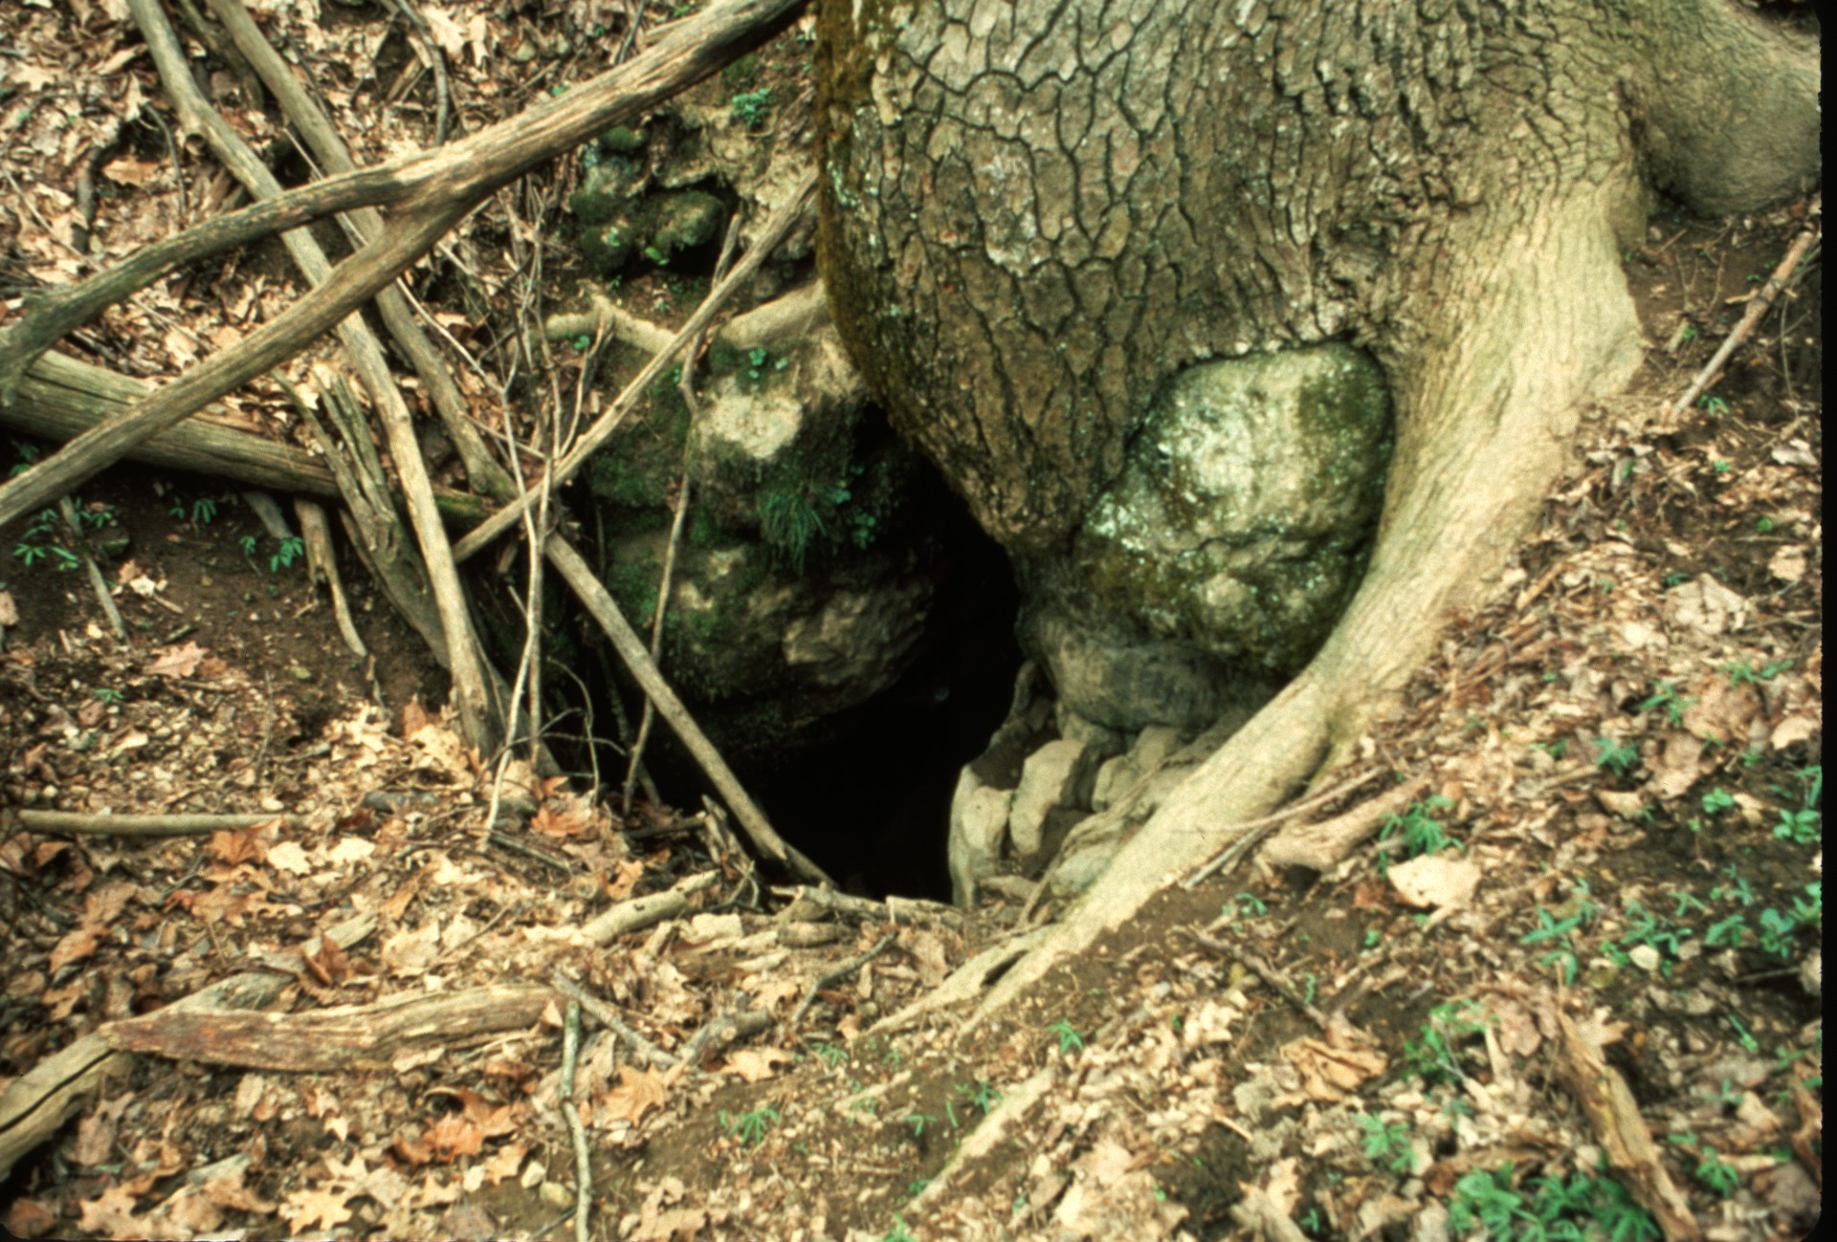
Notes:
Deems

Slide 19
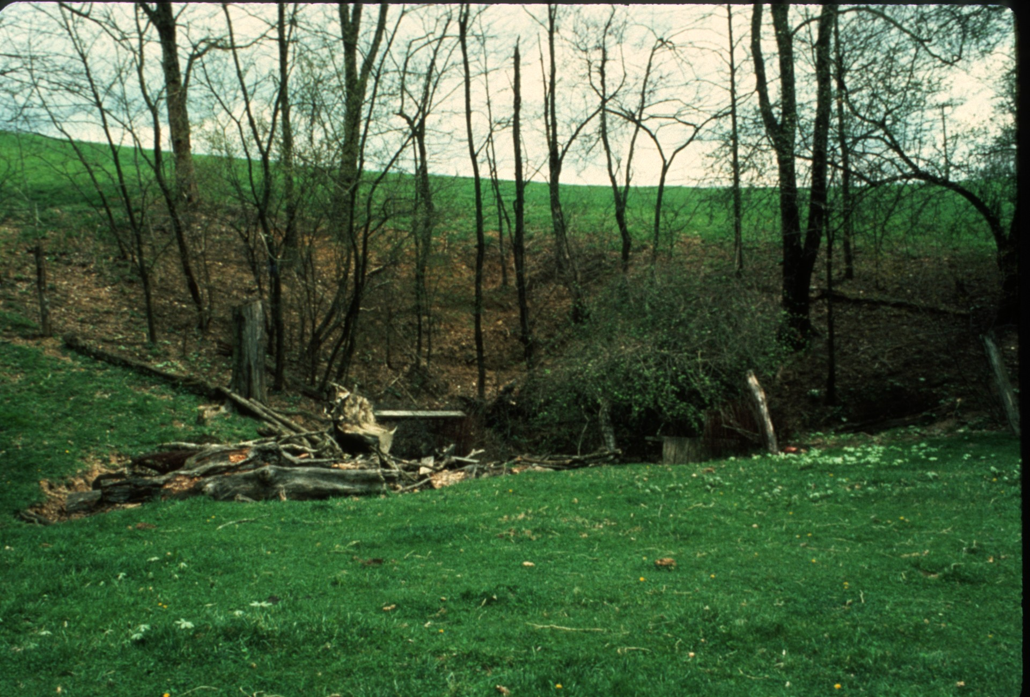
Notes:
Lipps

Slide 20
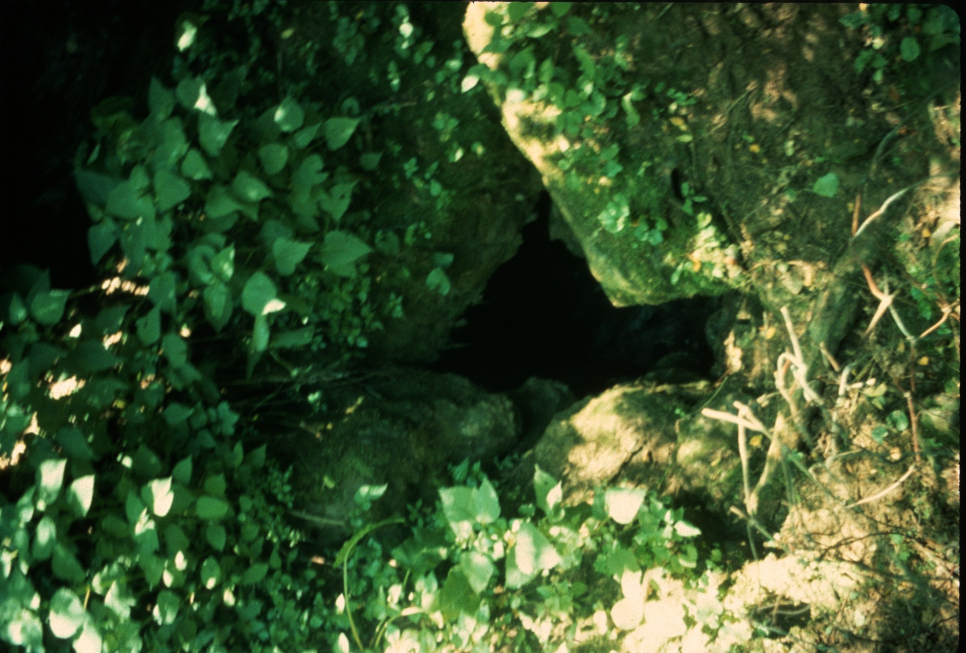
Notes:
Lipps

Slide 21
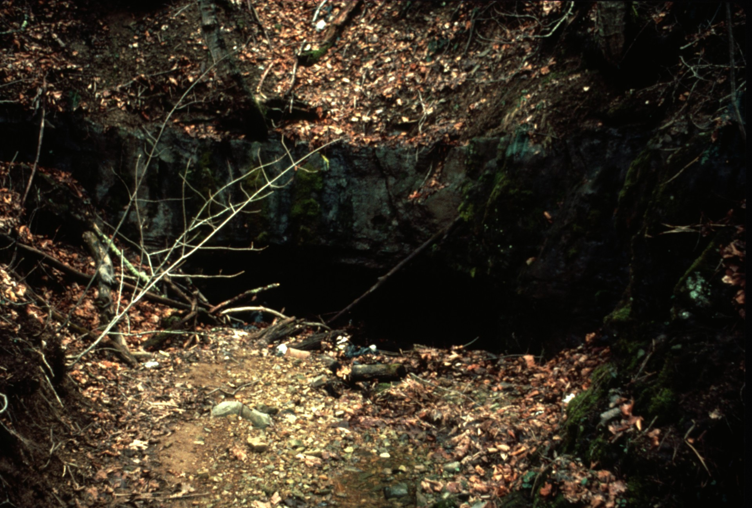
Notes:
Erwins

Slide 22
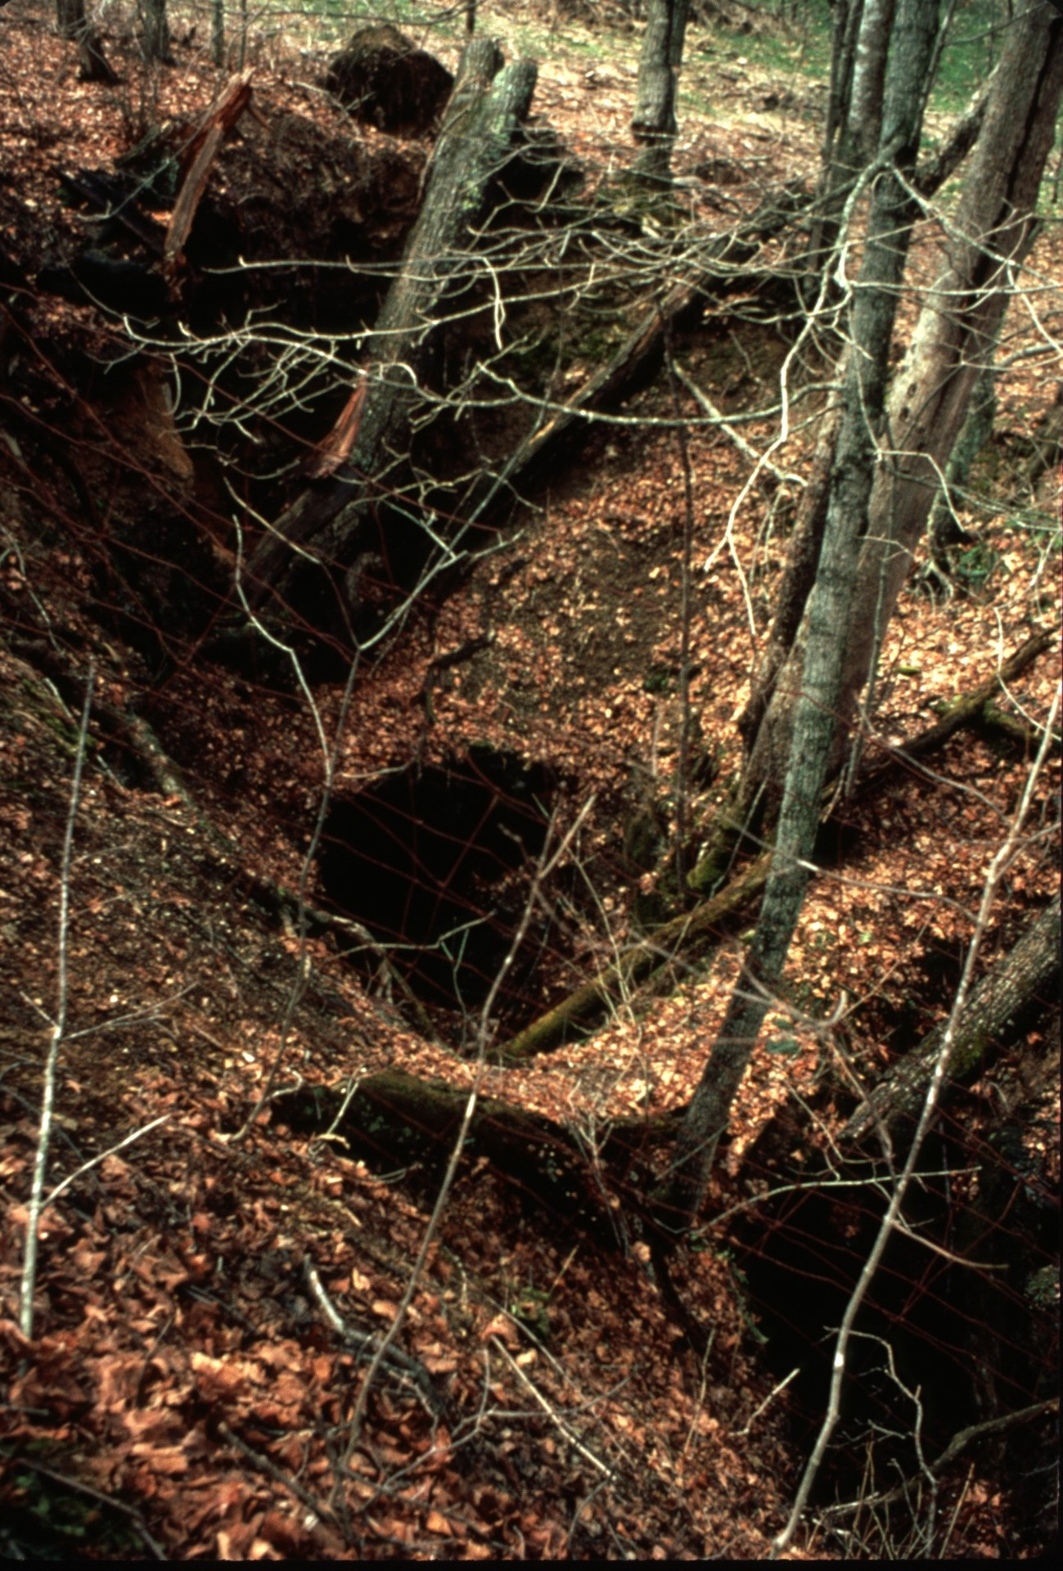
Notes:
Humphreys

Slide 23
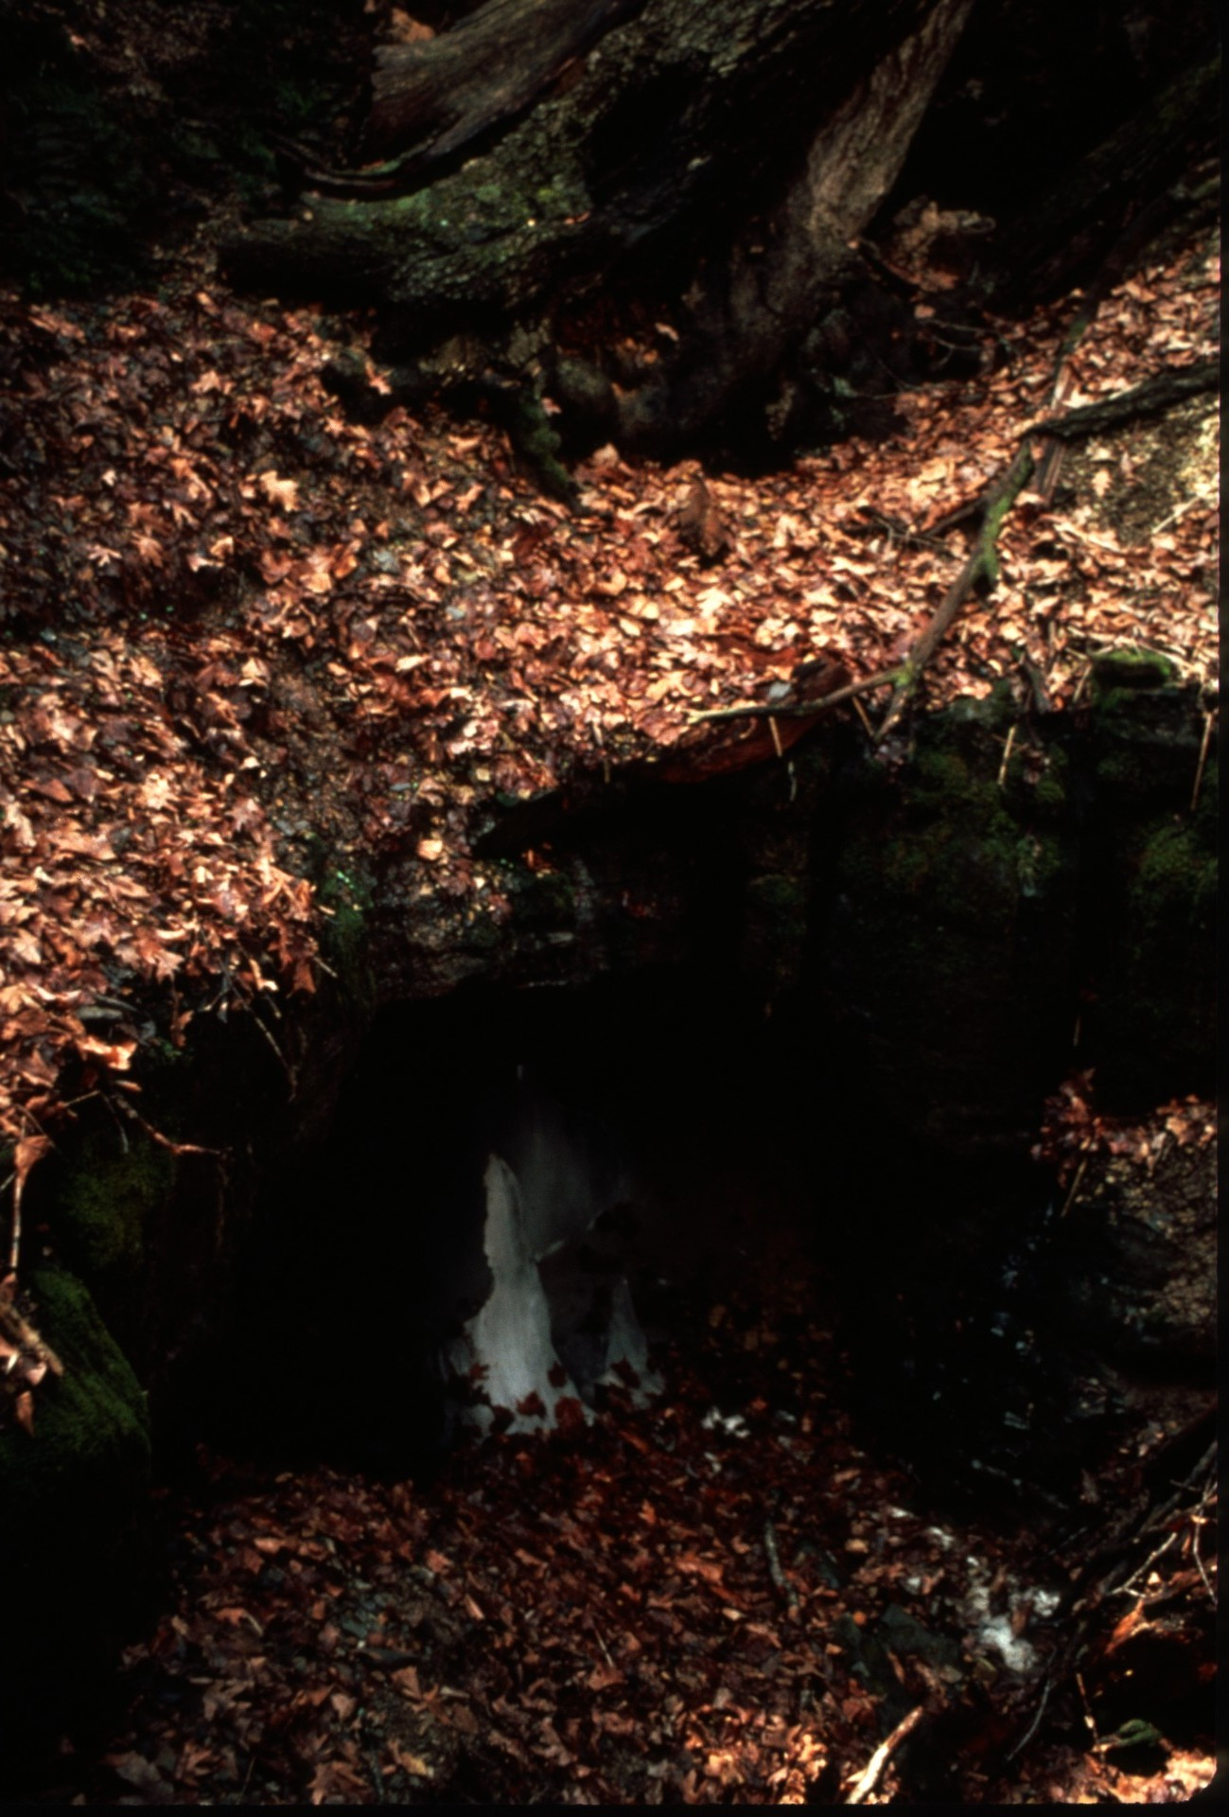
Notes:
Humphreys

Slide 24
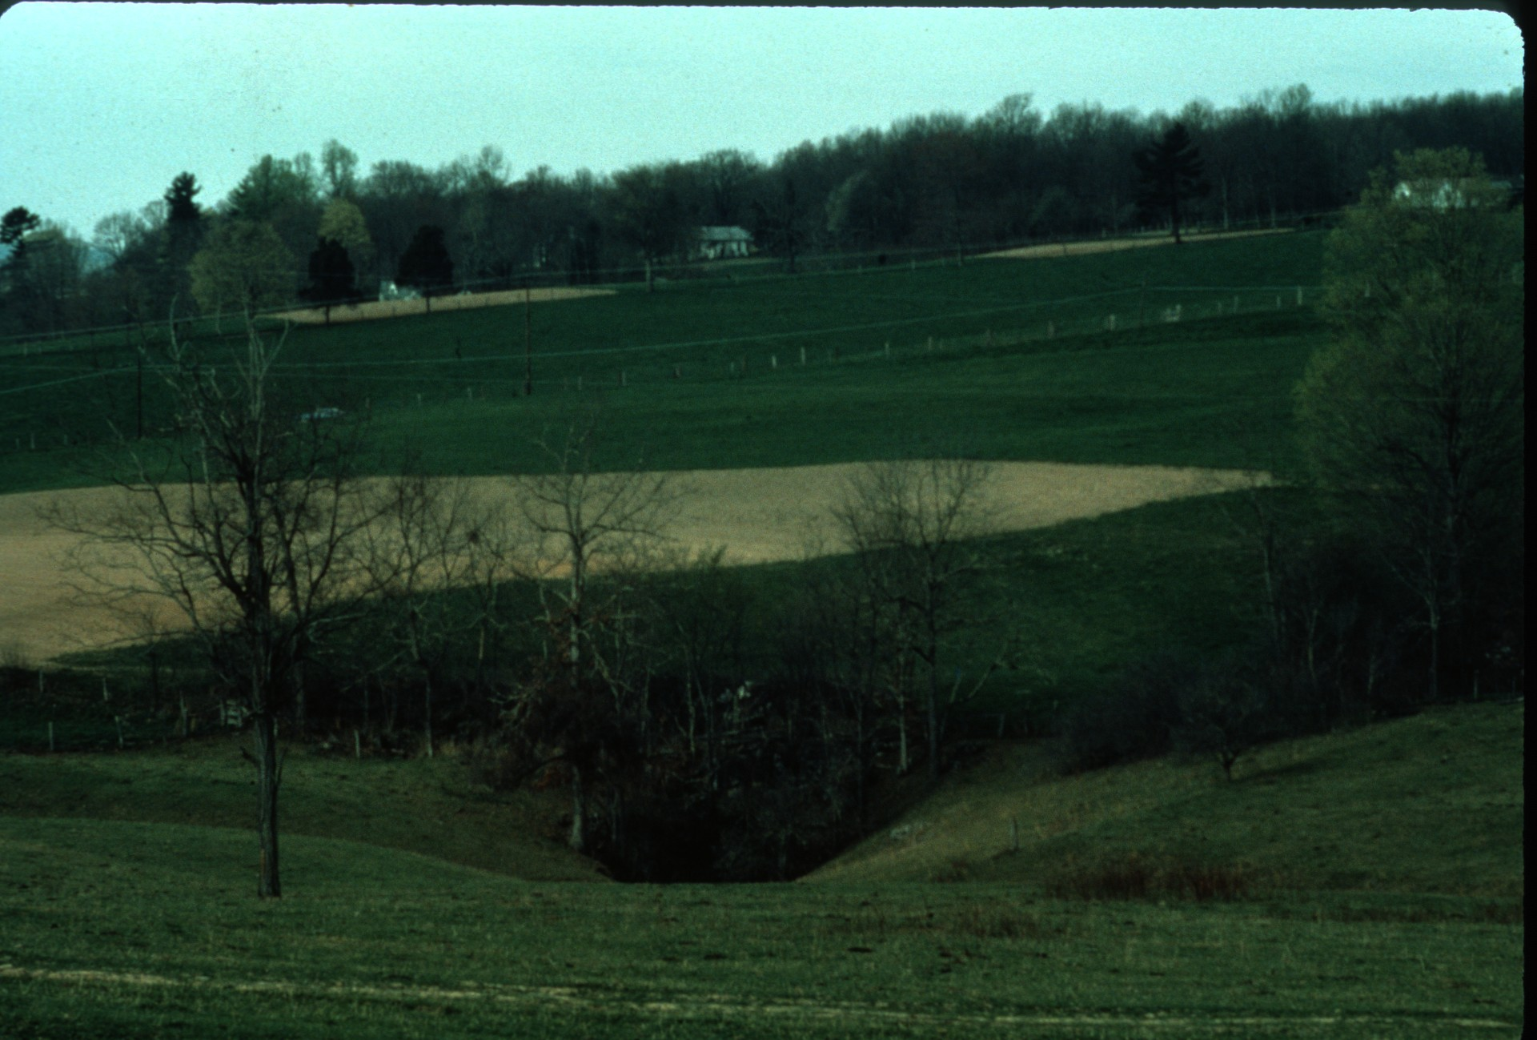
Notes:
While Foxhole Cave is surrounded by the Organ Cave System and its streams empty into Organ, a connection has yet to be made.

Slide 25
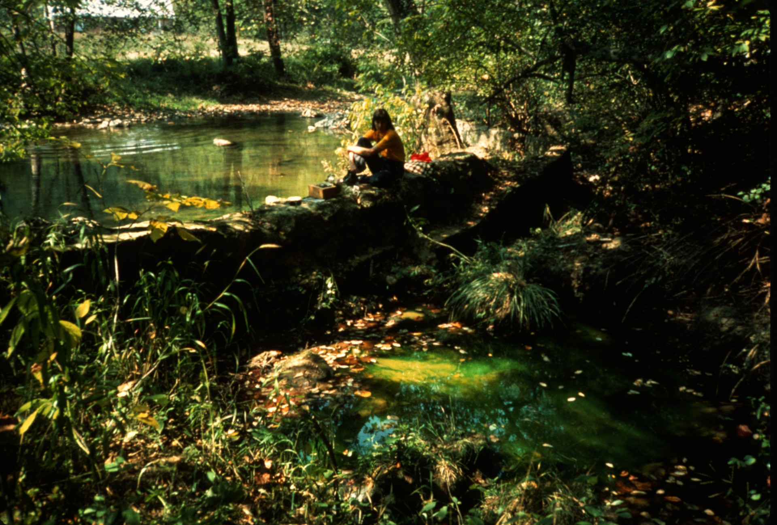
Notes:
All of the water in Organ Cave System comes out at the Organ Cave Resurgence on Second Creek.

Slide 26
Notes:
ln colonial times, Organ Cave was located on the Salt Sulphur Turnpike between the resorts at White Sulphur Springs and Salt Sulphur Springs.

Slide 27
Notes:
As early as the late 1700's tourists visited the cave which was famous for its namesake, a calcite formation which resembled a pipe organ.

Slide 28
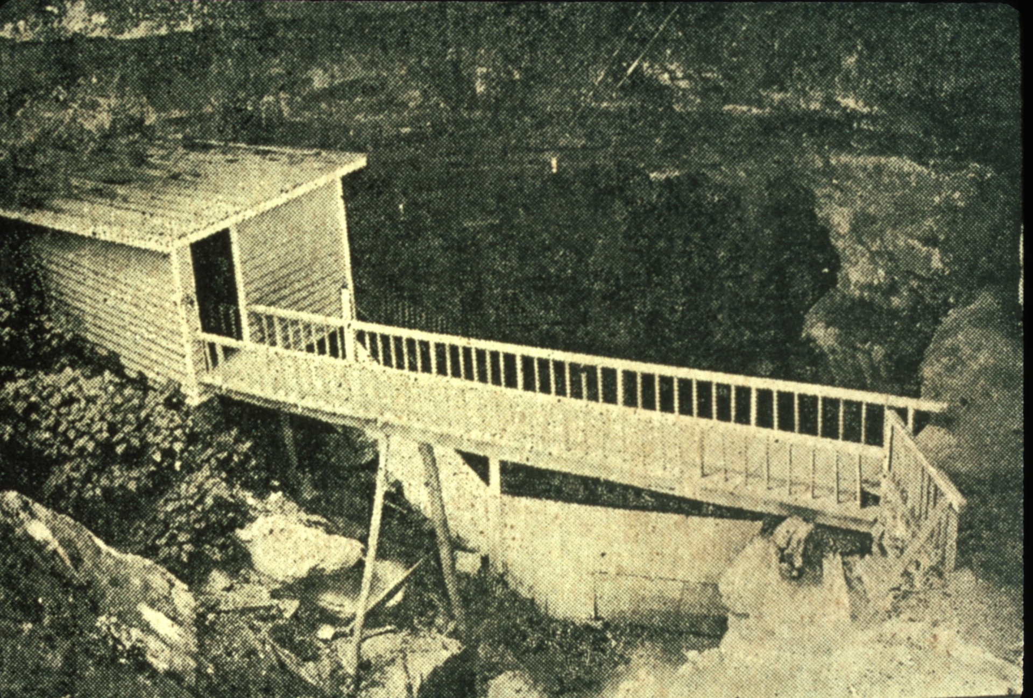
Notes:
By the late 1920s the cave had been commercially developed.

Slide 29
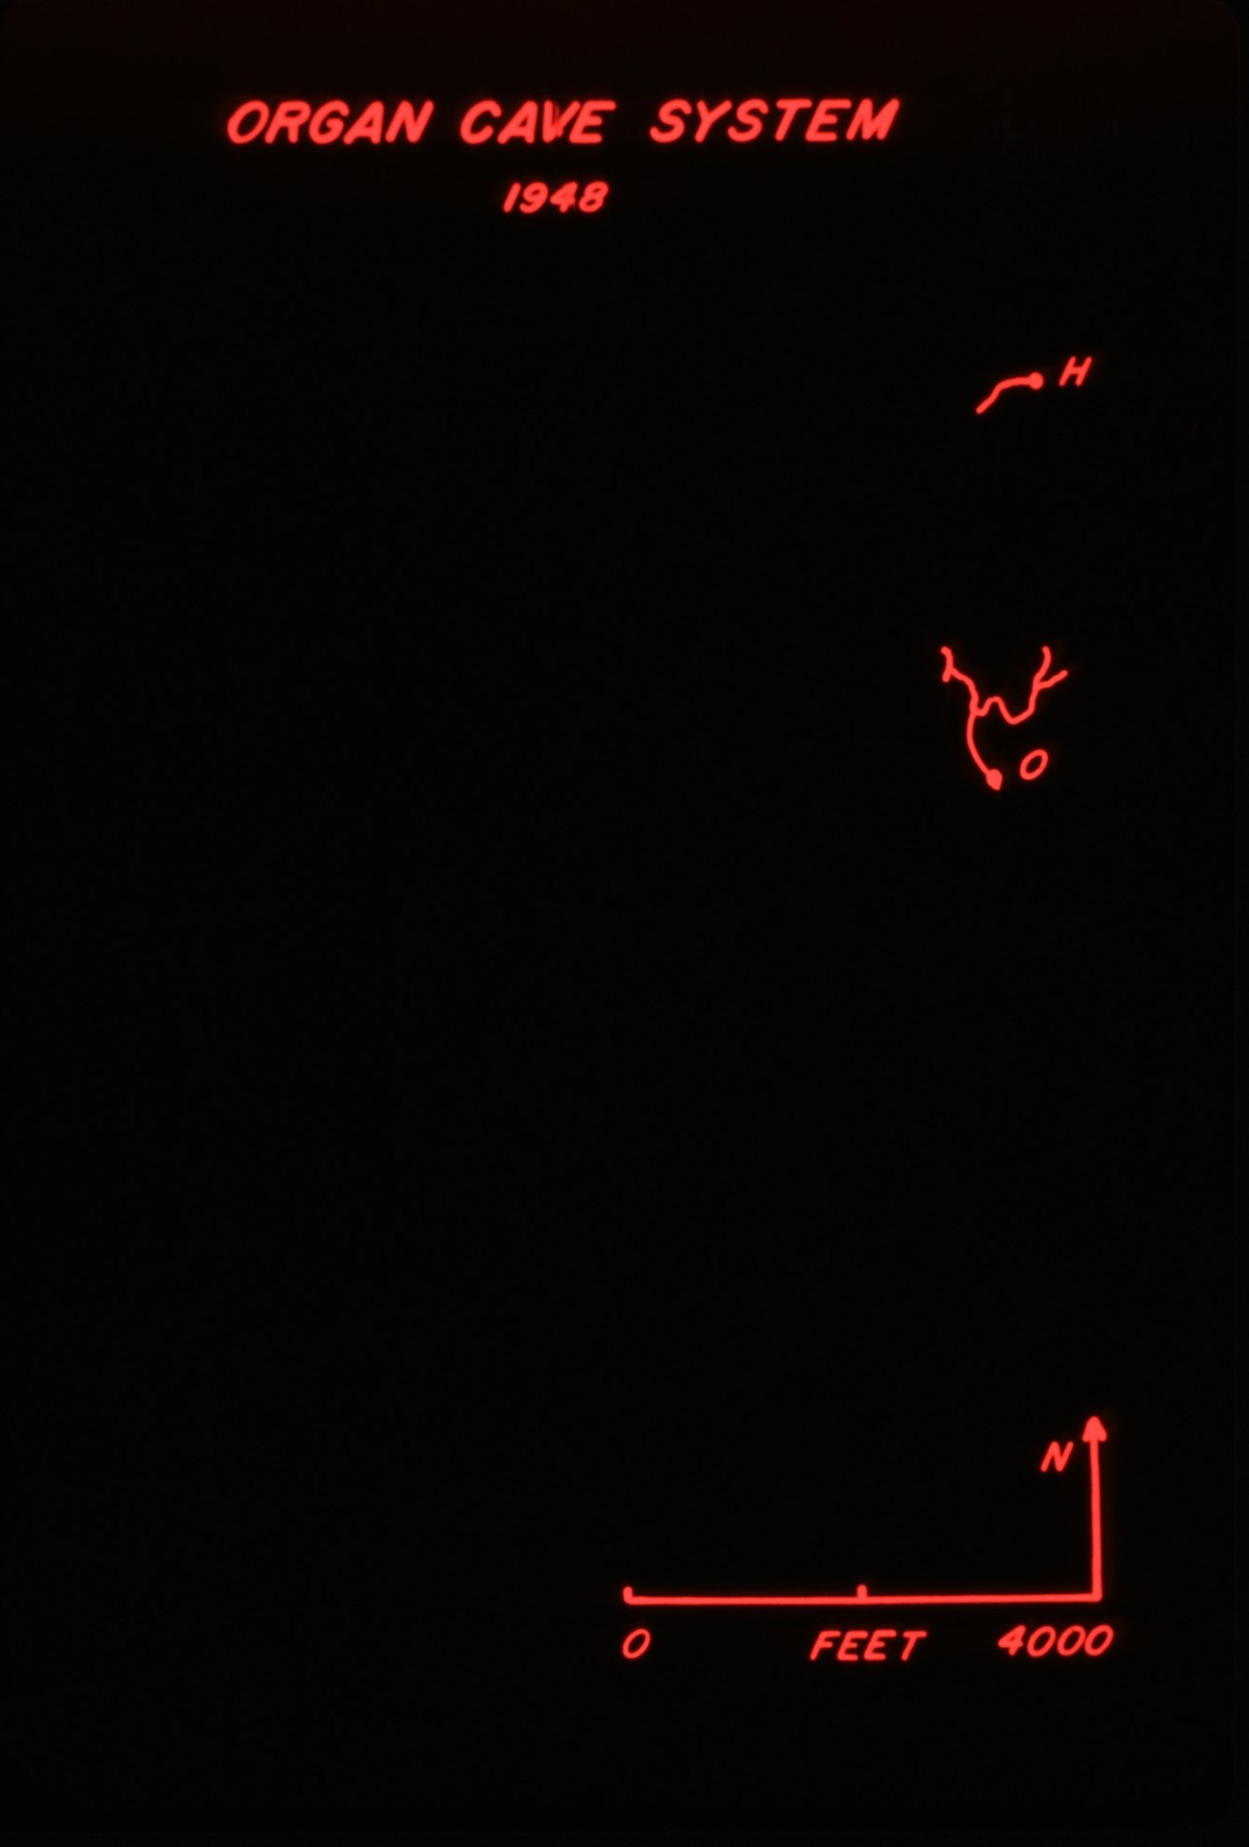
Notes:
Prior to 1949, only the commercial section of Organ Cave was known. Hedricks Cave, a small pretty cave about a mile north of Organ, was thought to end at the "water hazard."

Slide 30
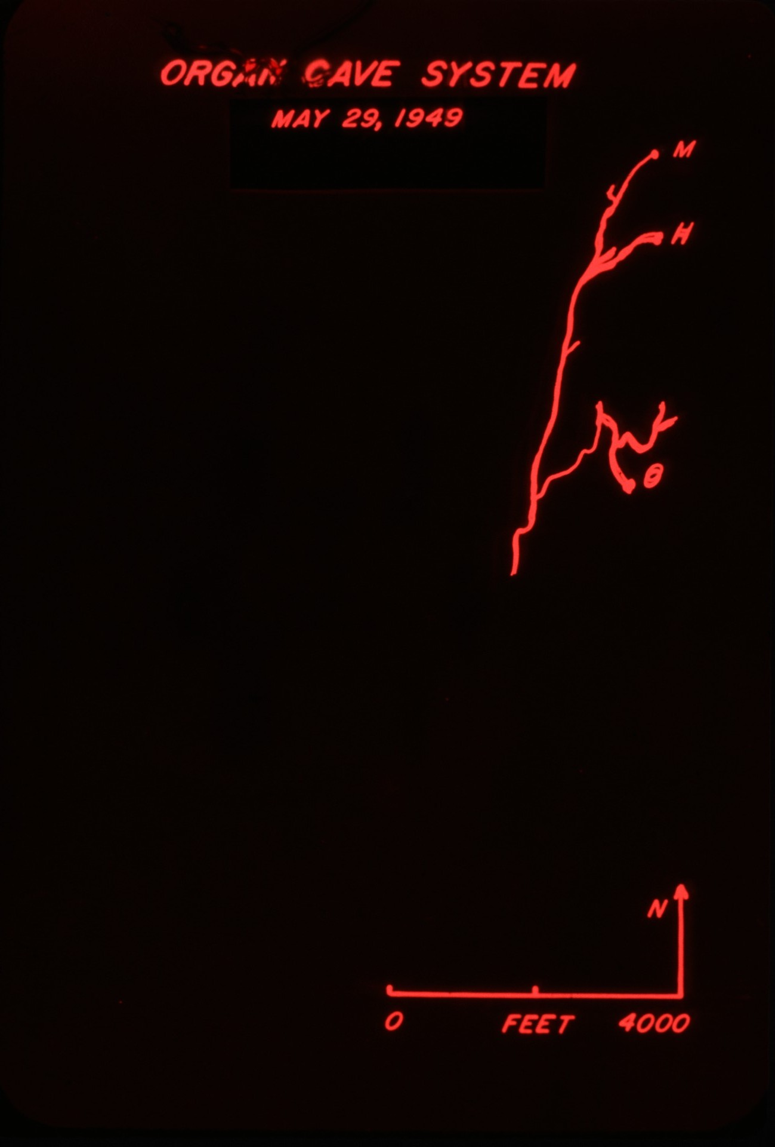
Notes:
Then in May 1i949, three Charleston cavers (Bob Flack, Bob Barnes and Bob Handley) entered Hedricks Cave, bypassed the water hazard and proceeded down Hedricks Stream Passage, and up Organ Main Stream Passage. They exited Organ Cave amidst electric lights and tourists.

Slide 31
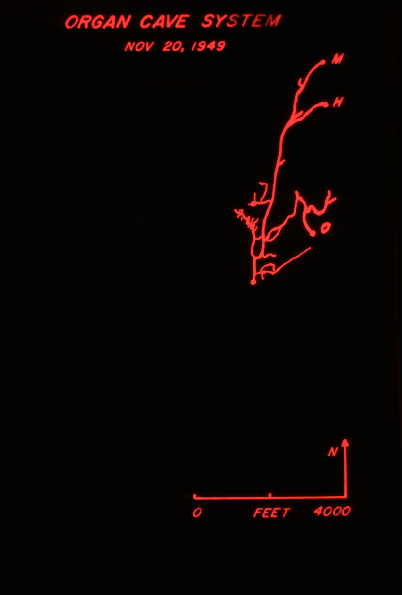
Notes:
By November 1949 cavers had explored the Organ section of the developing cave system finding the Flack and Handley Rooms, Hedricks Maze, Waterfall Room, and Cyclops Hall.

Slide 32
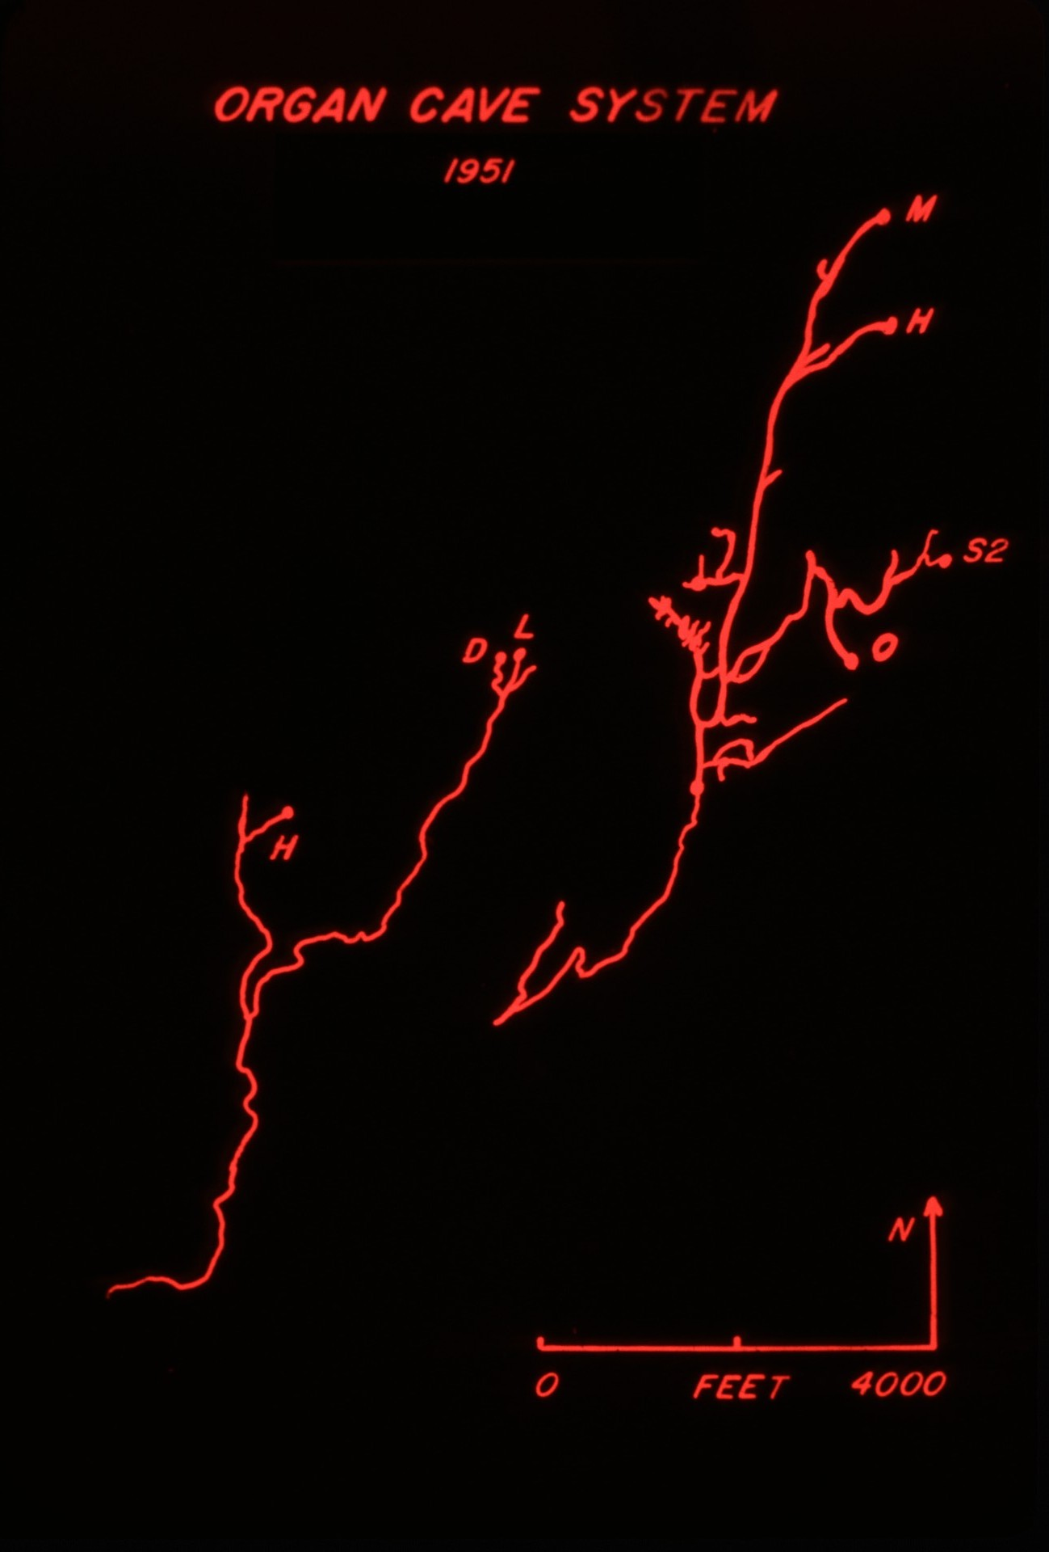
Notes:
Bob Handley and John Rutherford extensively explored two other small caves located about a mile west of Organ, known as Humphreys and Lipps, and connected them in 1951. Meanwhile, back in Organ Cave cavers explored Big Canyon, Meatgrinder and the Jones Canyon Maze.

Slide 33
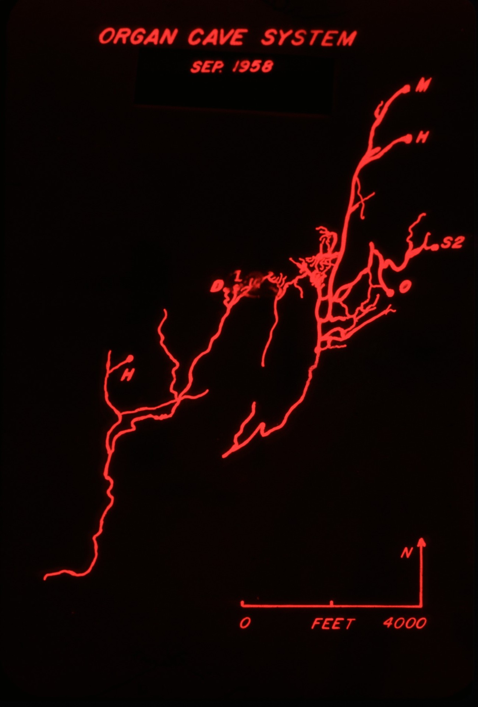
Notes:
Then Lipps-Humphreys was connected to Organ-Hedricks.

Slide 34
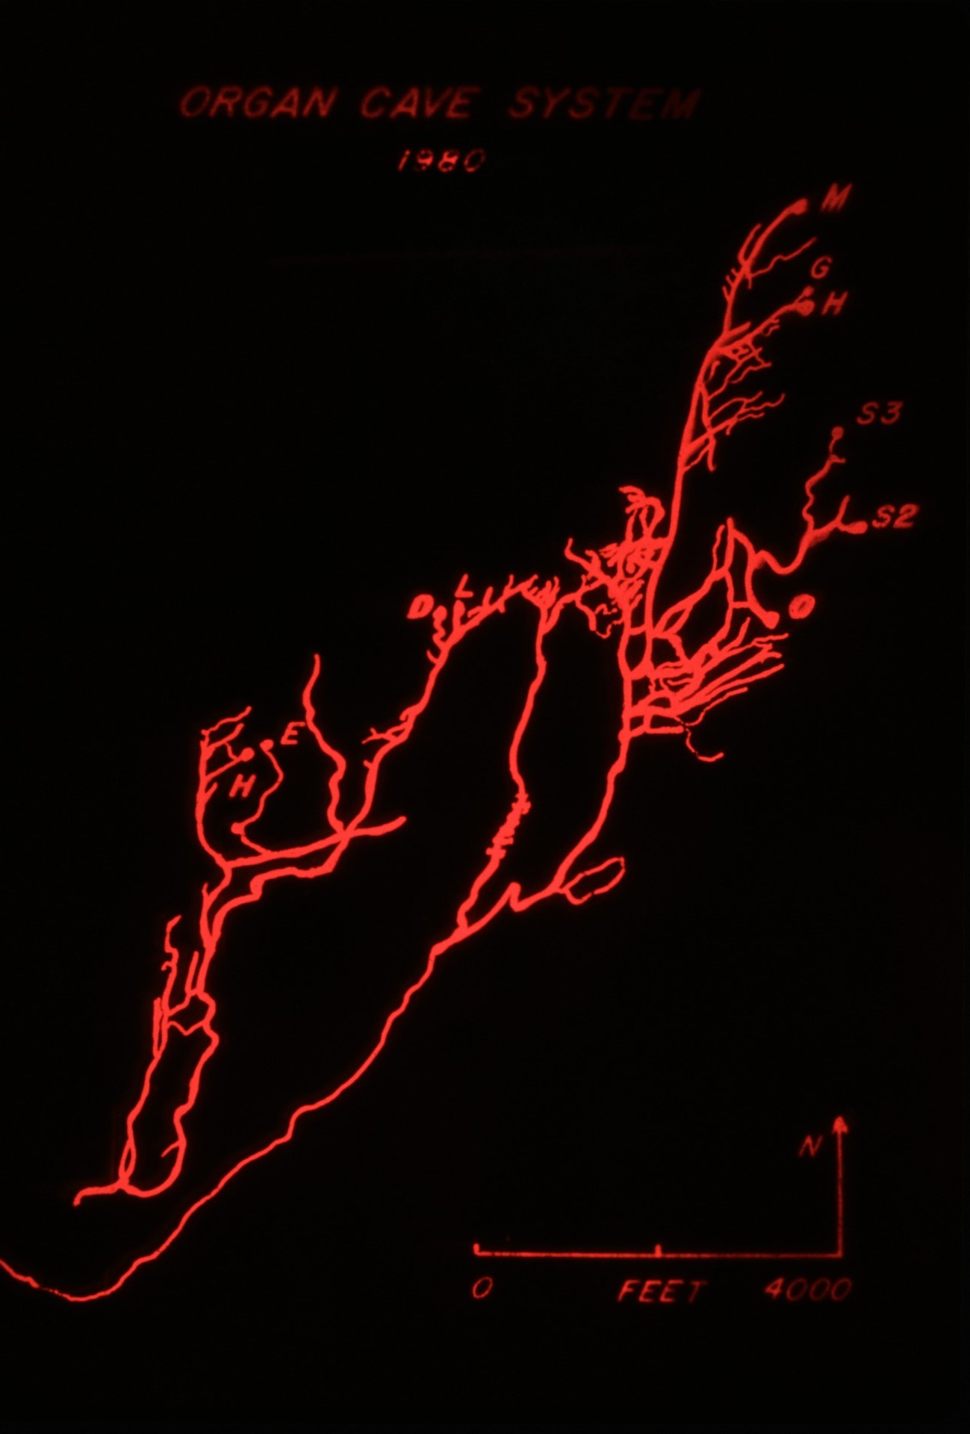
Notes:
After much exploration and survey by West Virginia Association for Cave Studies (WVACS) and the NSS District of Columbia Grotto (DCG), 37 miles of passage had been mapped by 1980.

Slide 35
Notes:
Let's take a typical Organ Cave System trip…

Slide 36
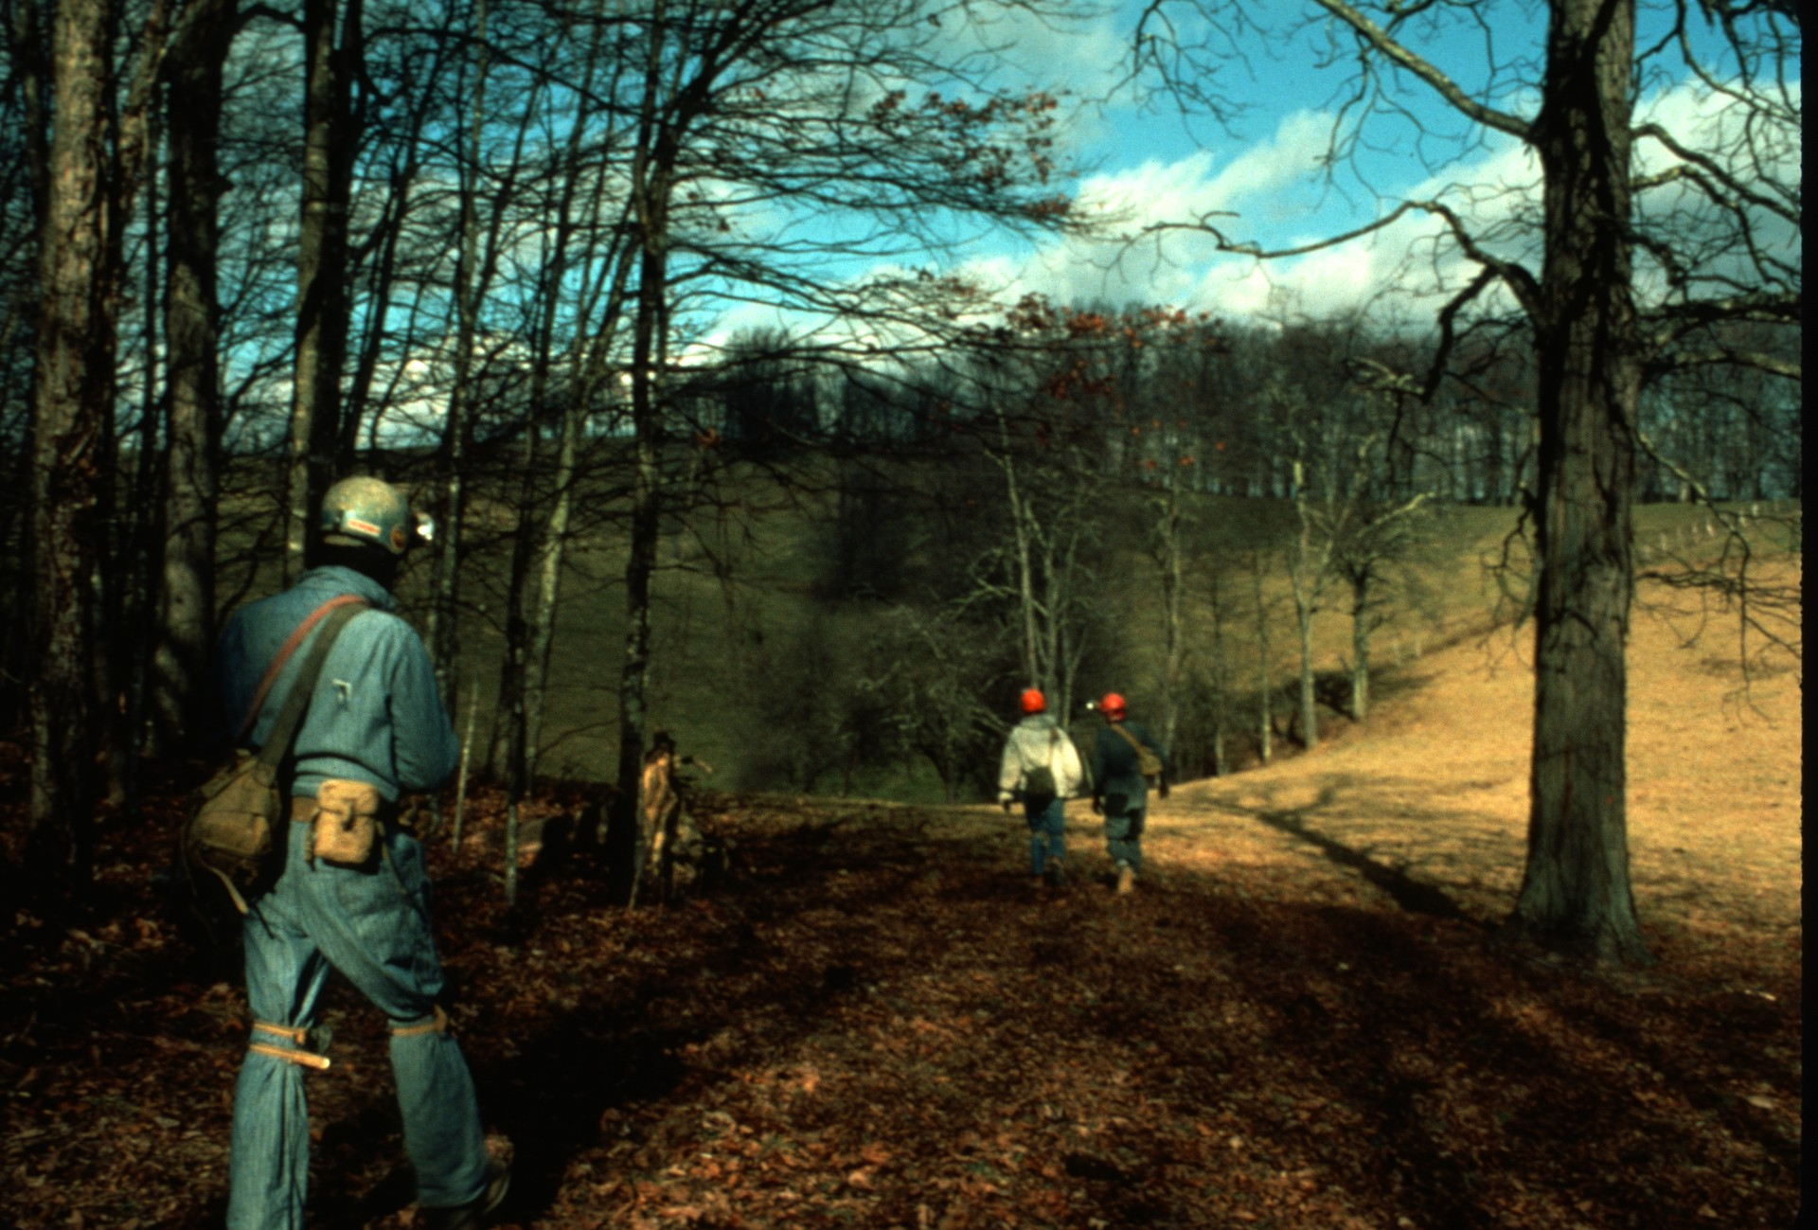
Notes:
…entering the Lipps entrance and exiting Organ.

Slide 37
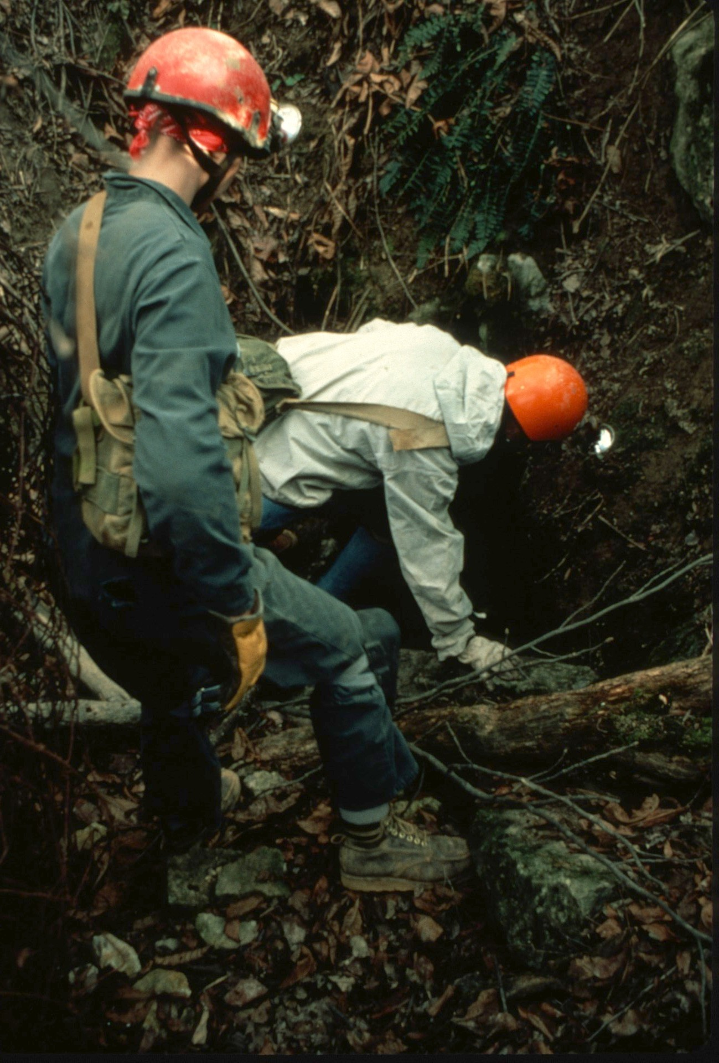
Notes:
The Lipps entrance immediately opens into a small room that leads to the Lipps Stream Passage.

Slide 38
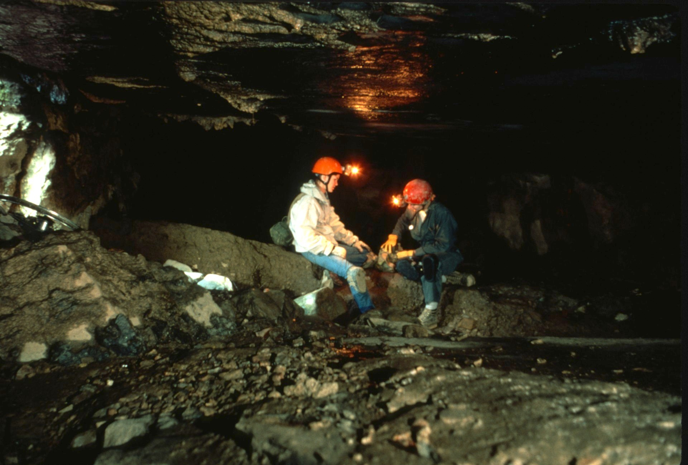
Notes:
Walking is easy until exiting into a side lead off the stream and into Lipps Maze.

Slide 39
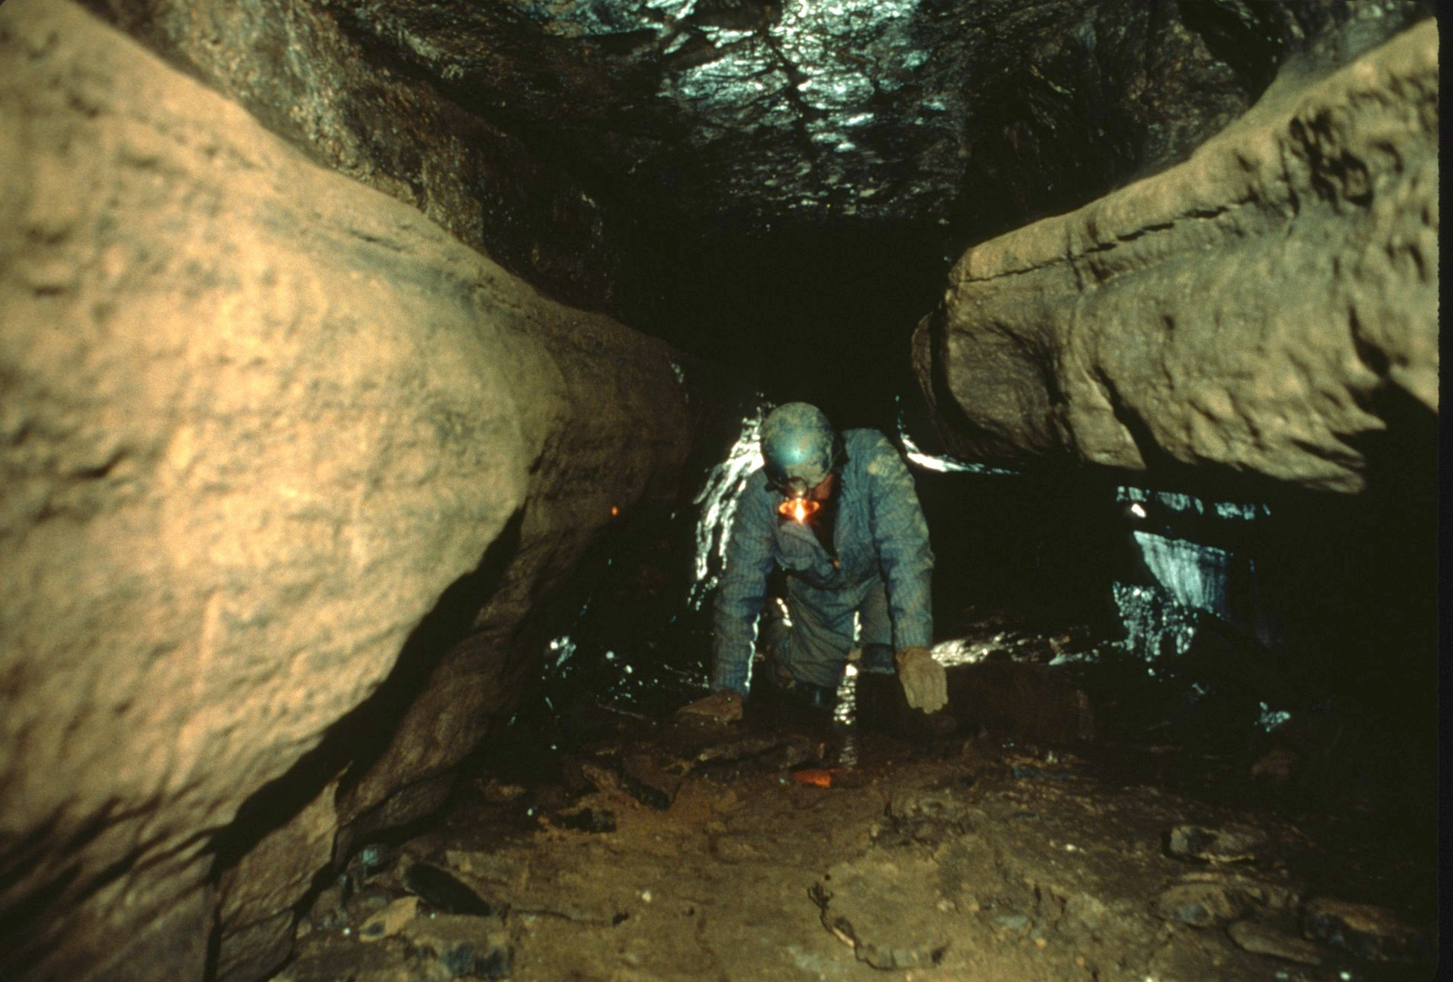
Notes:
Negotiating the dry maze of passages …

Slide 40
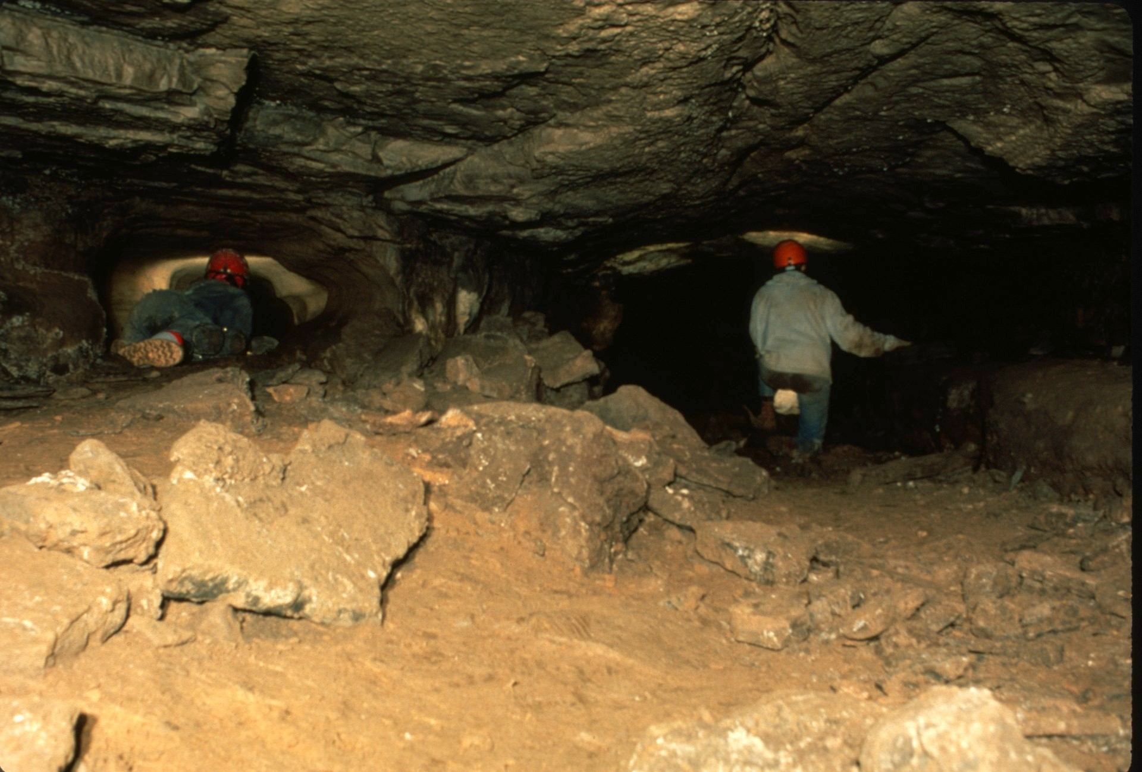

Slide 41
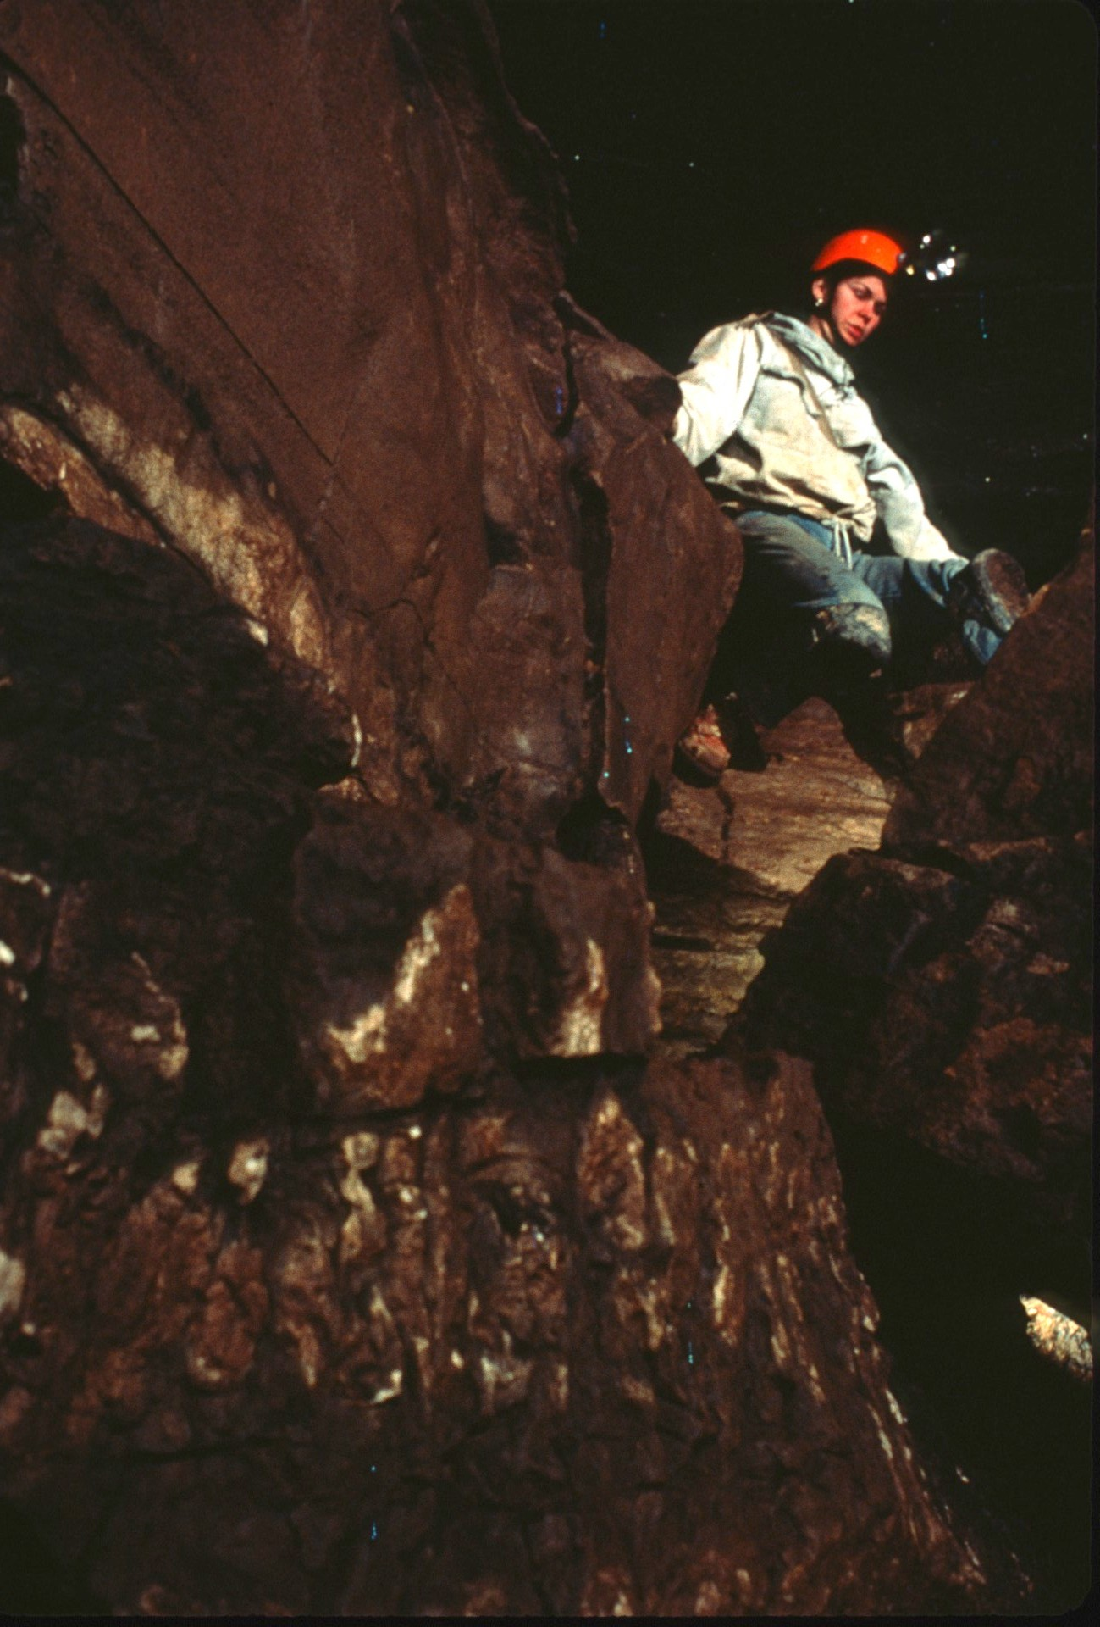
Notes:
…leads to Skid Row, a tributary stream passage…

Slide 42
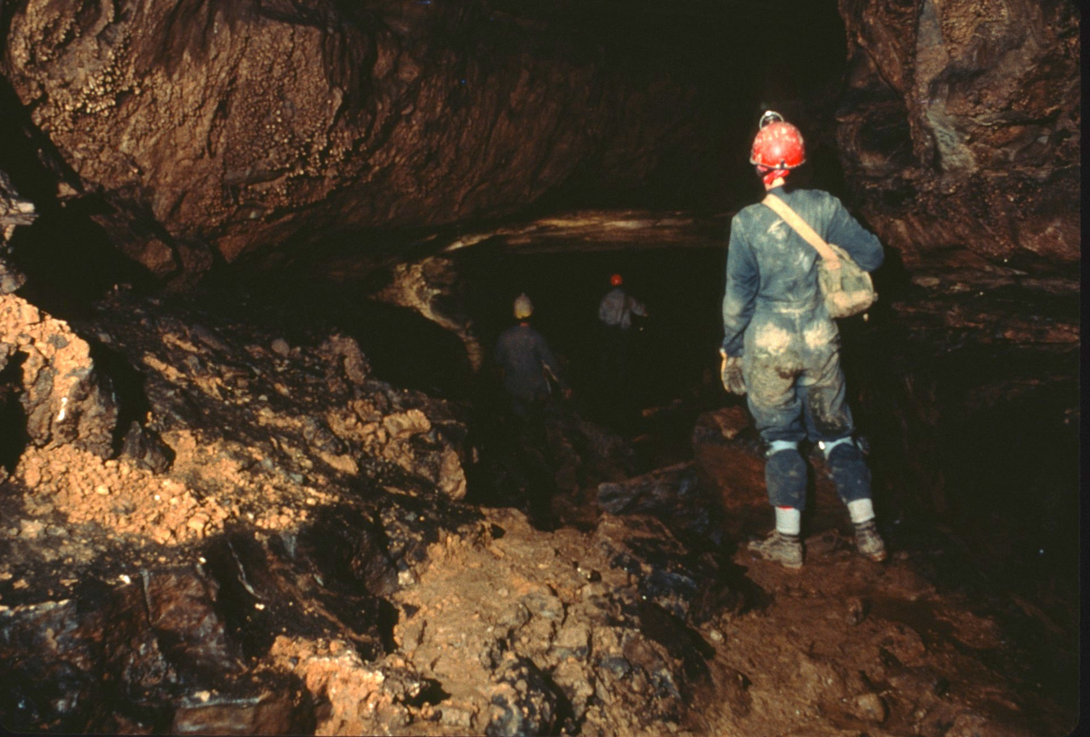
Notes:
into Jones Canyon.

Slide 43
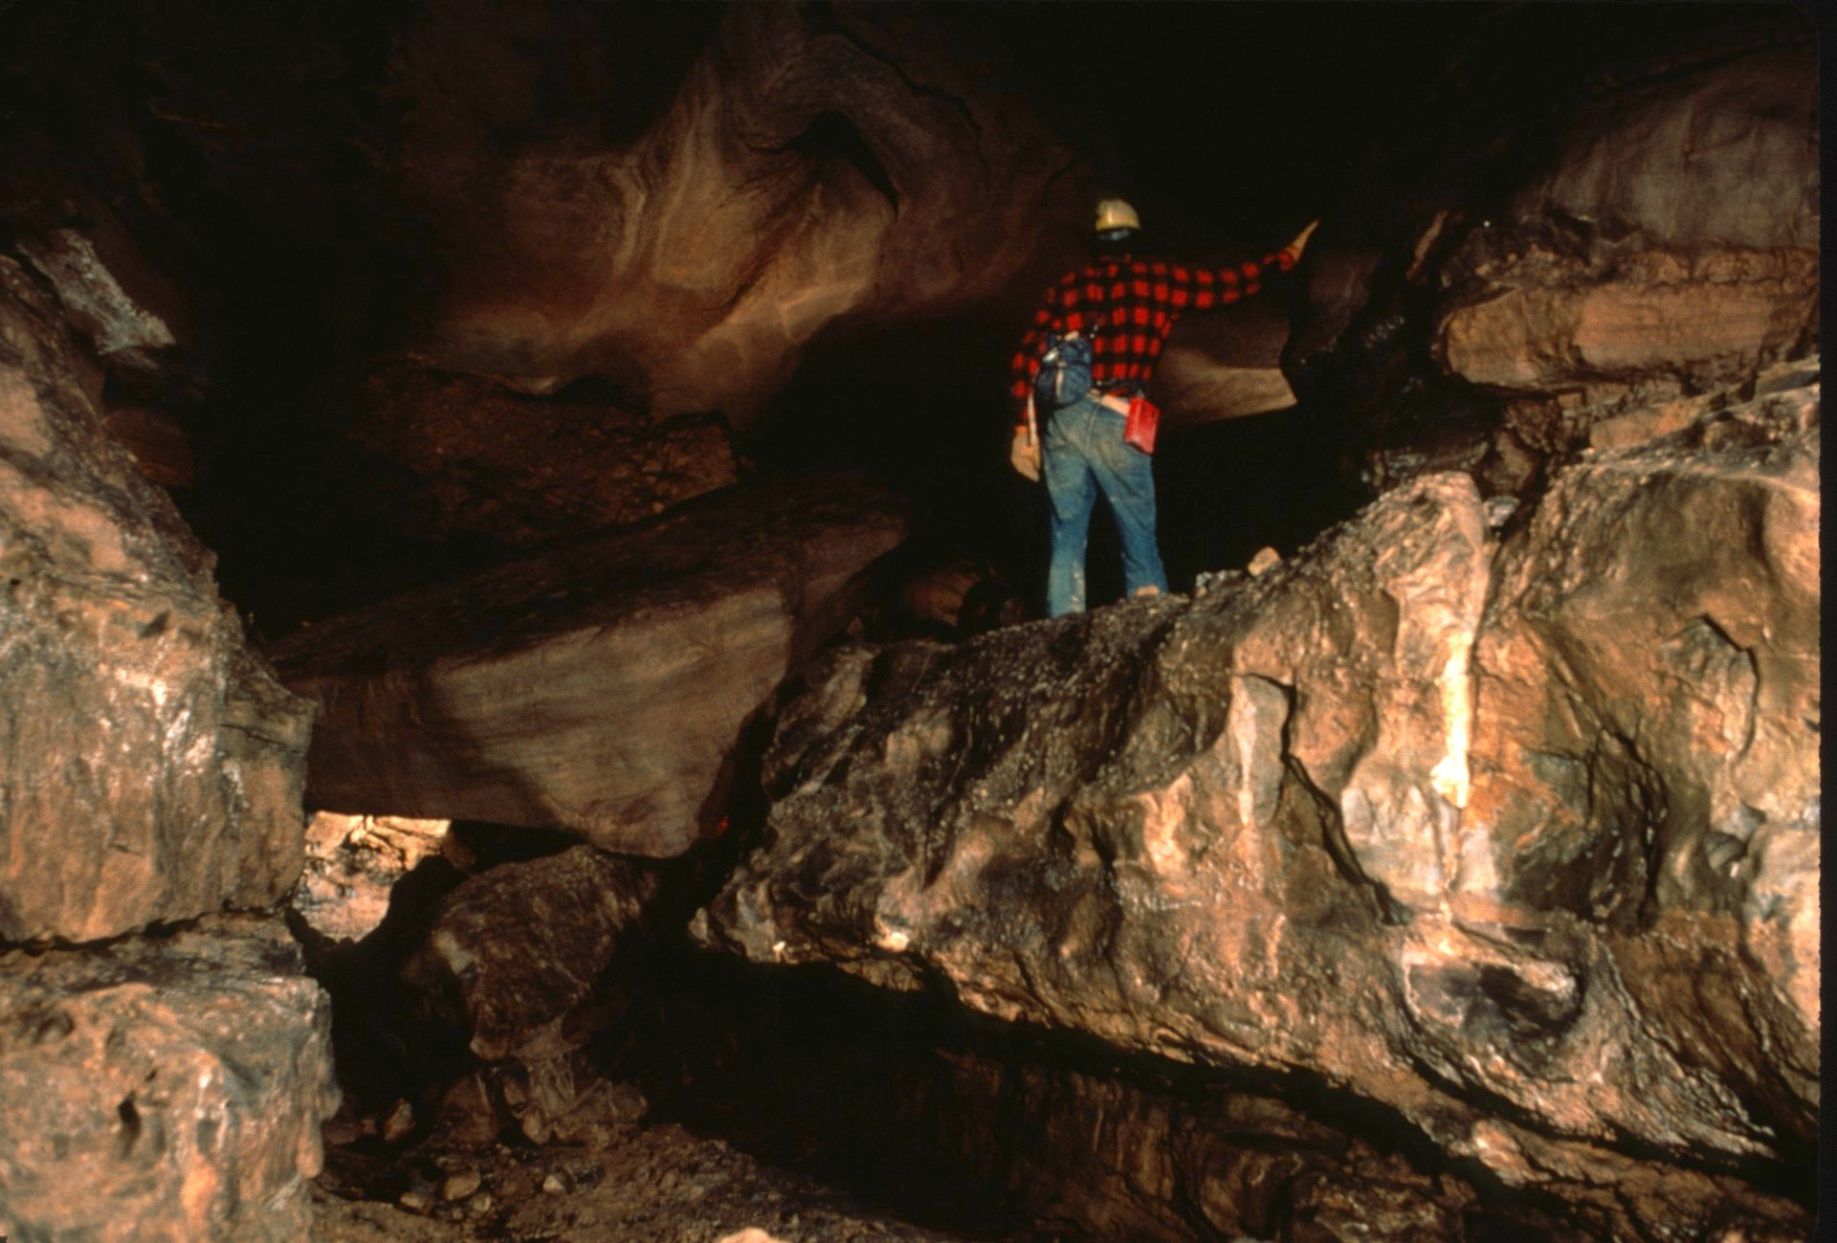

Slide 44
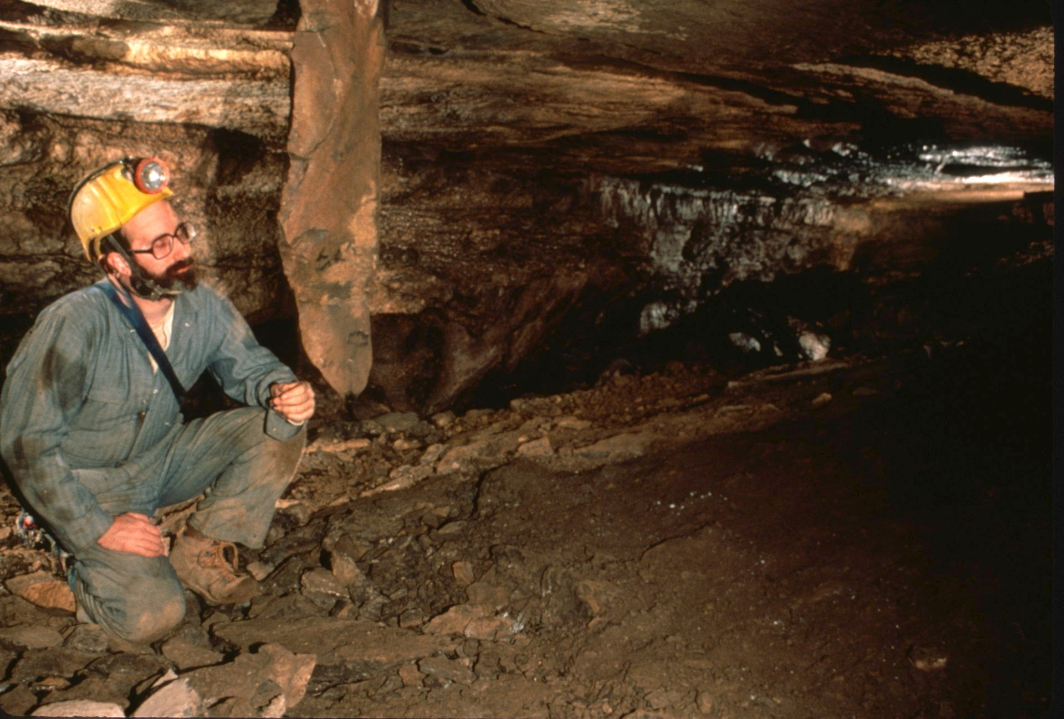
Notes:
After heading north and upstream in Jones Canyon, the Pendulum…

Slide 45
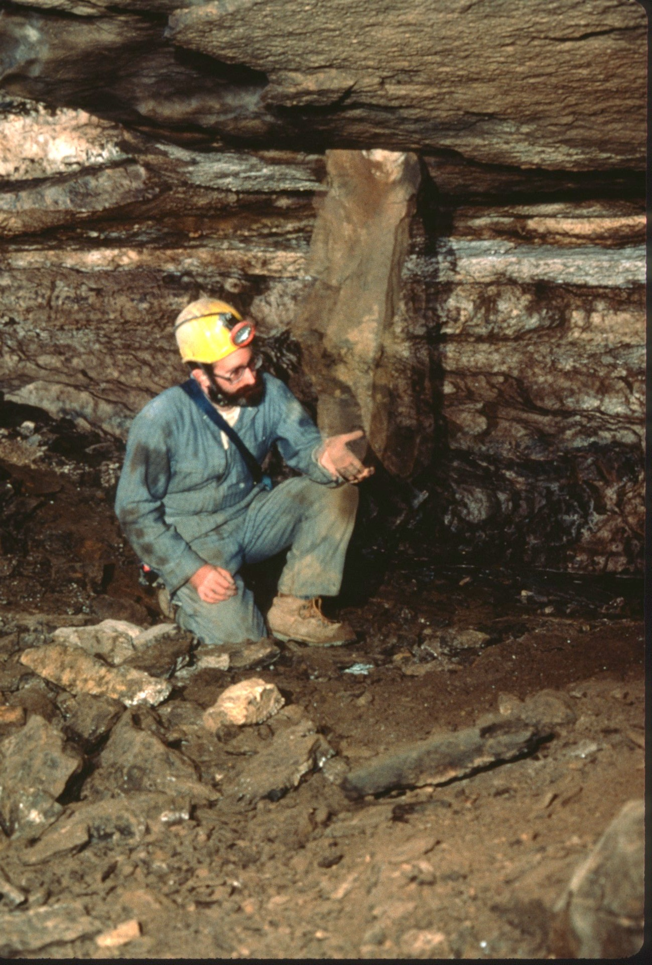

Slide 46
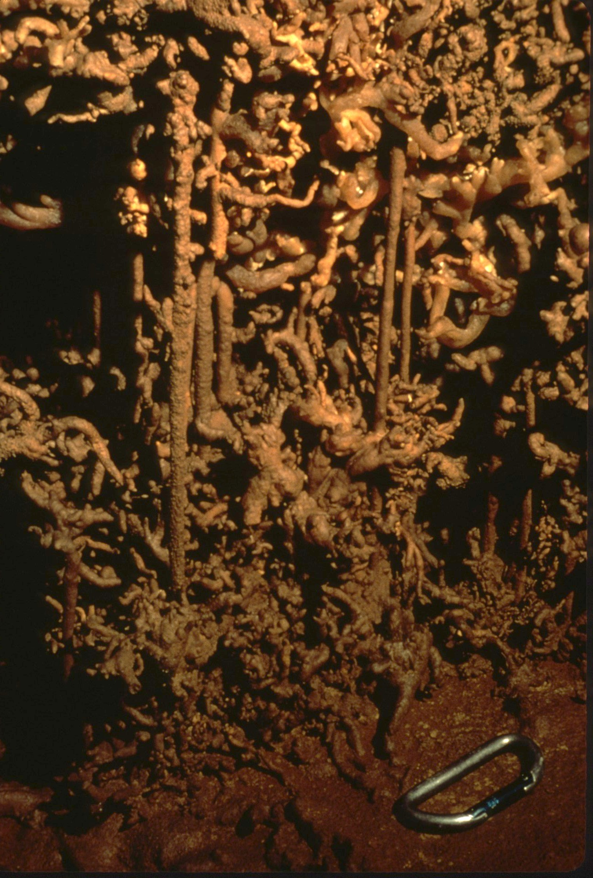
Notes:
and Treasure Passage provide interesting diversions.

Slide 47
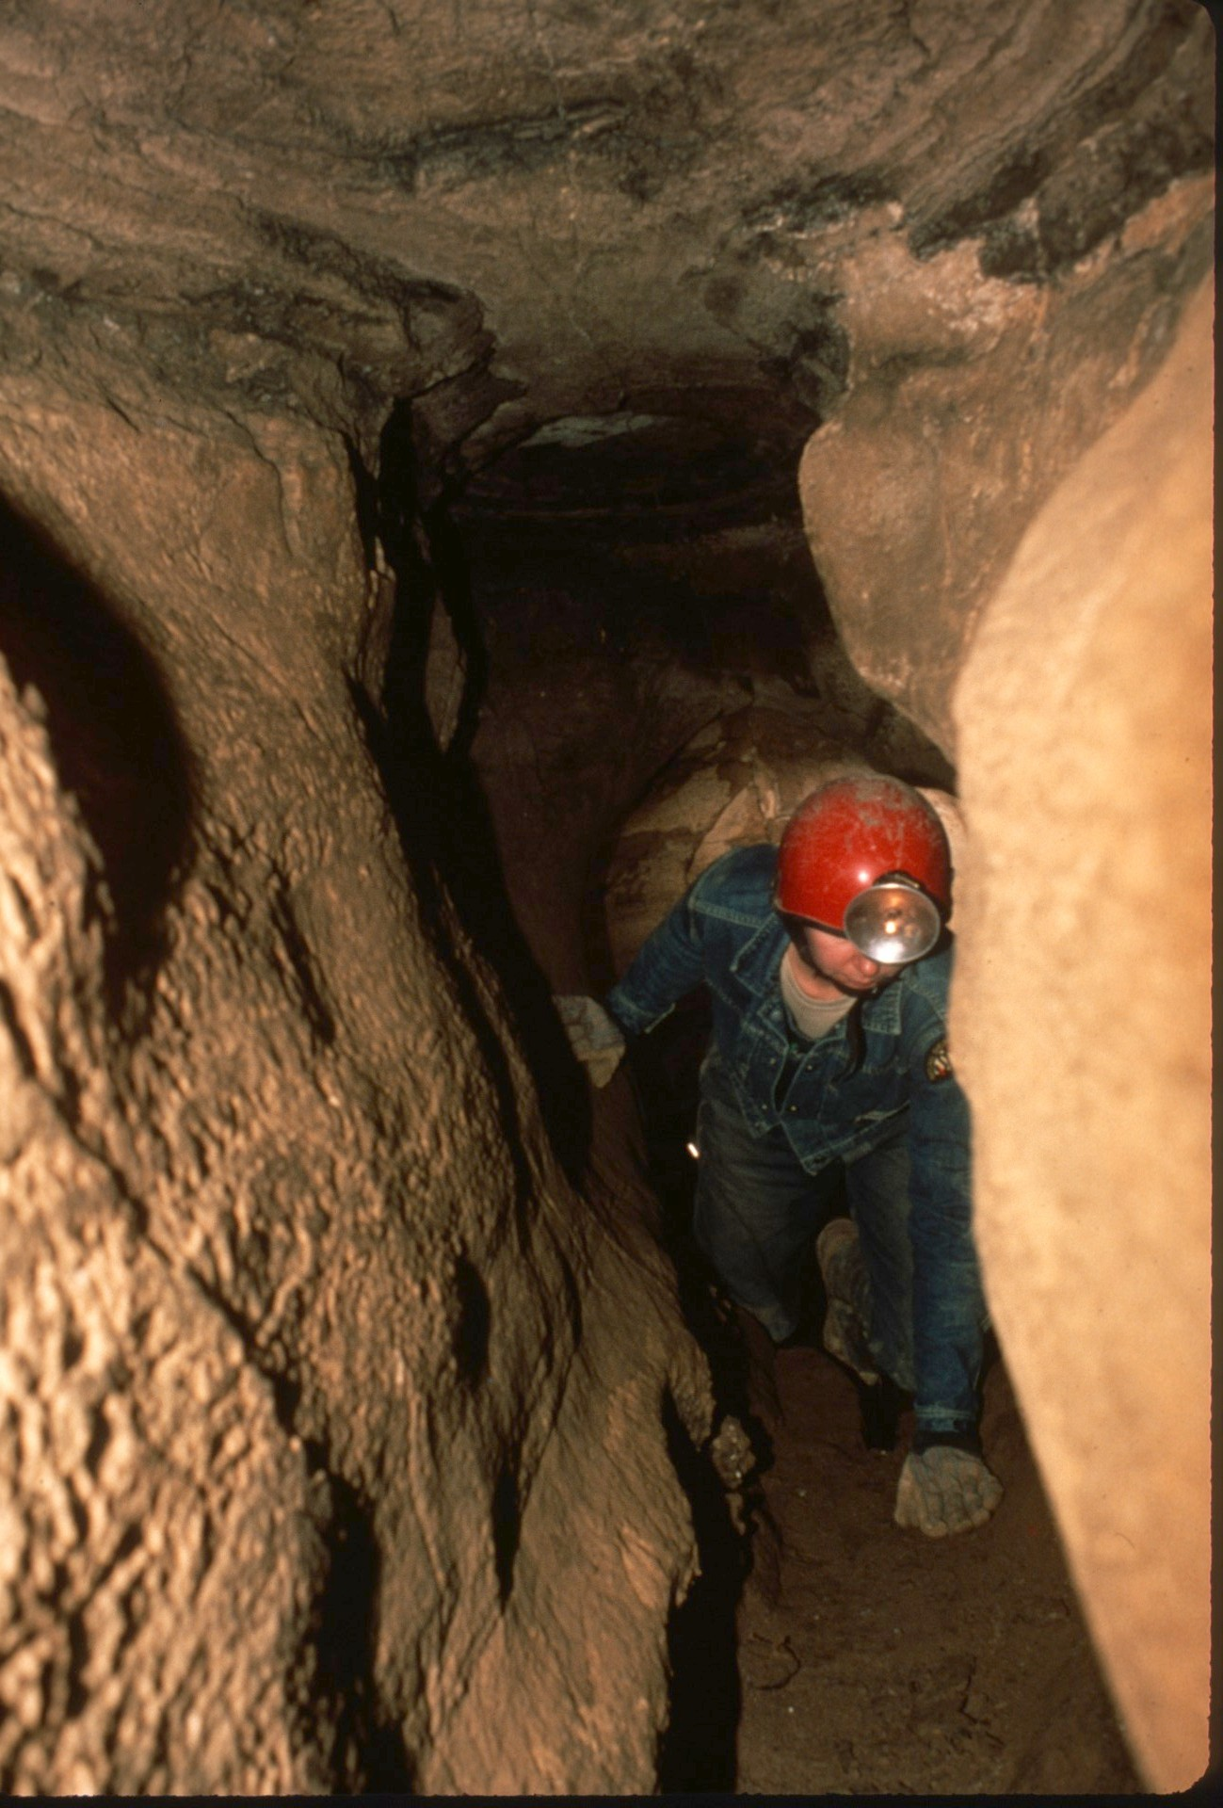
Notes:
The low crawl and narrow crevice that form the Breezeway provide a connection to the Organ section of the cave.

Slide 48
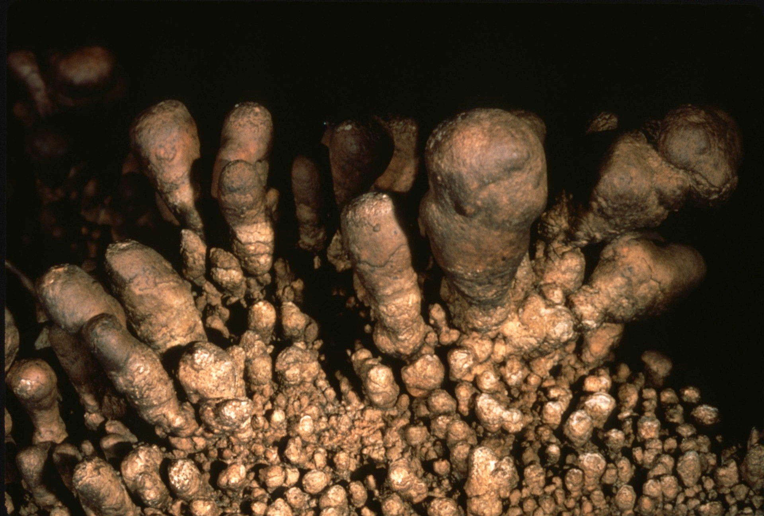
Notes:
An interesting formation marks the exit.

Slide 49
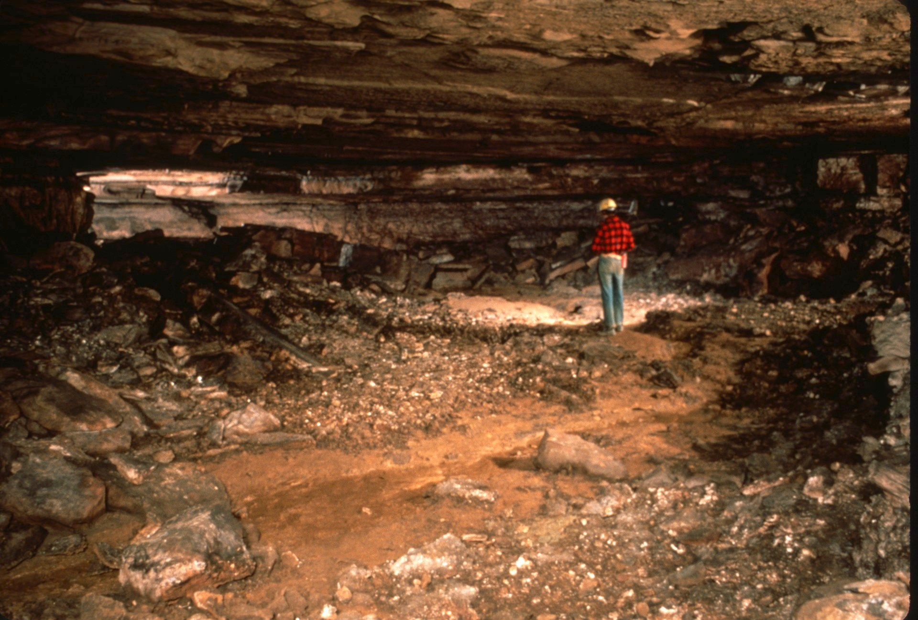
Notes:
The Left Hand Passage is large and easy going, quite a change after the crawls in upper Jones Canyon.

Slide 50
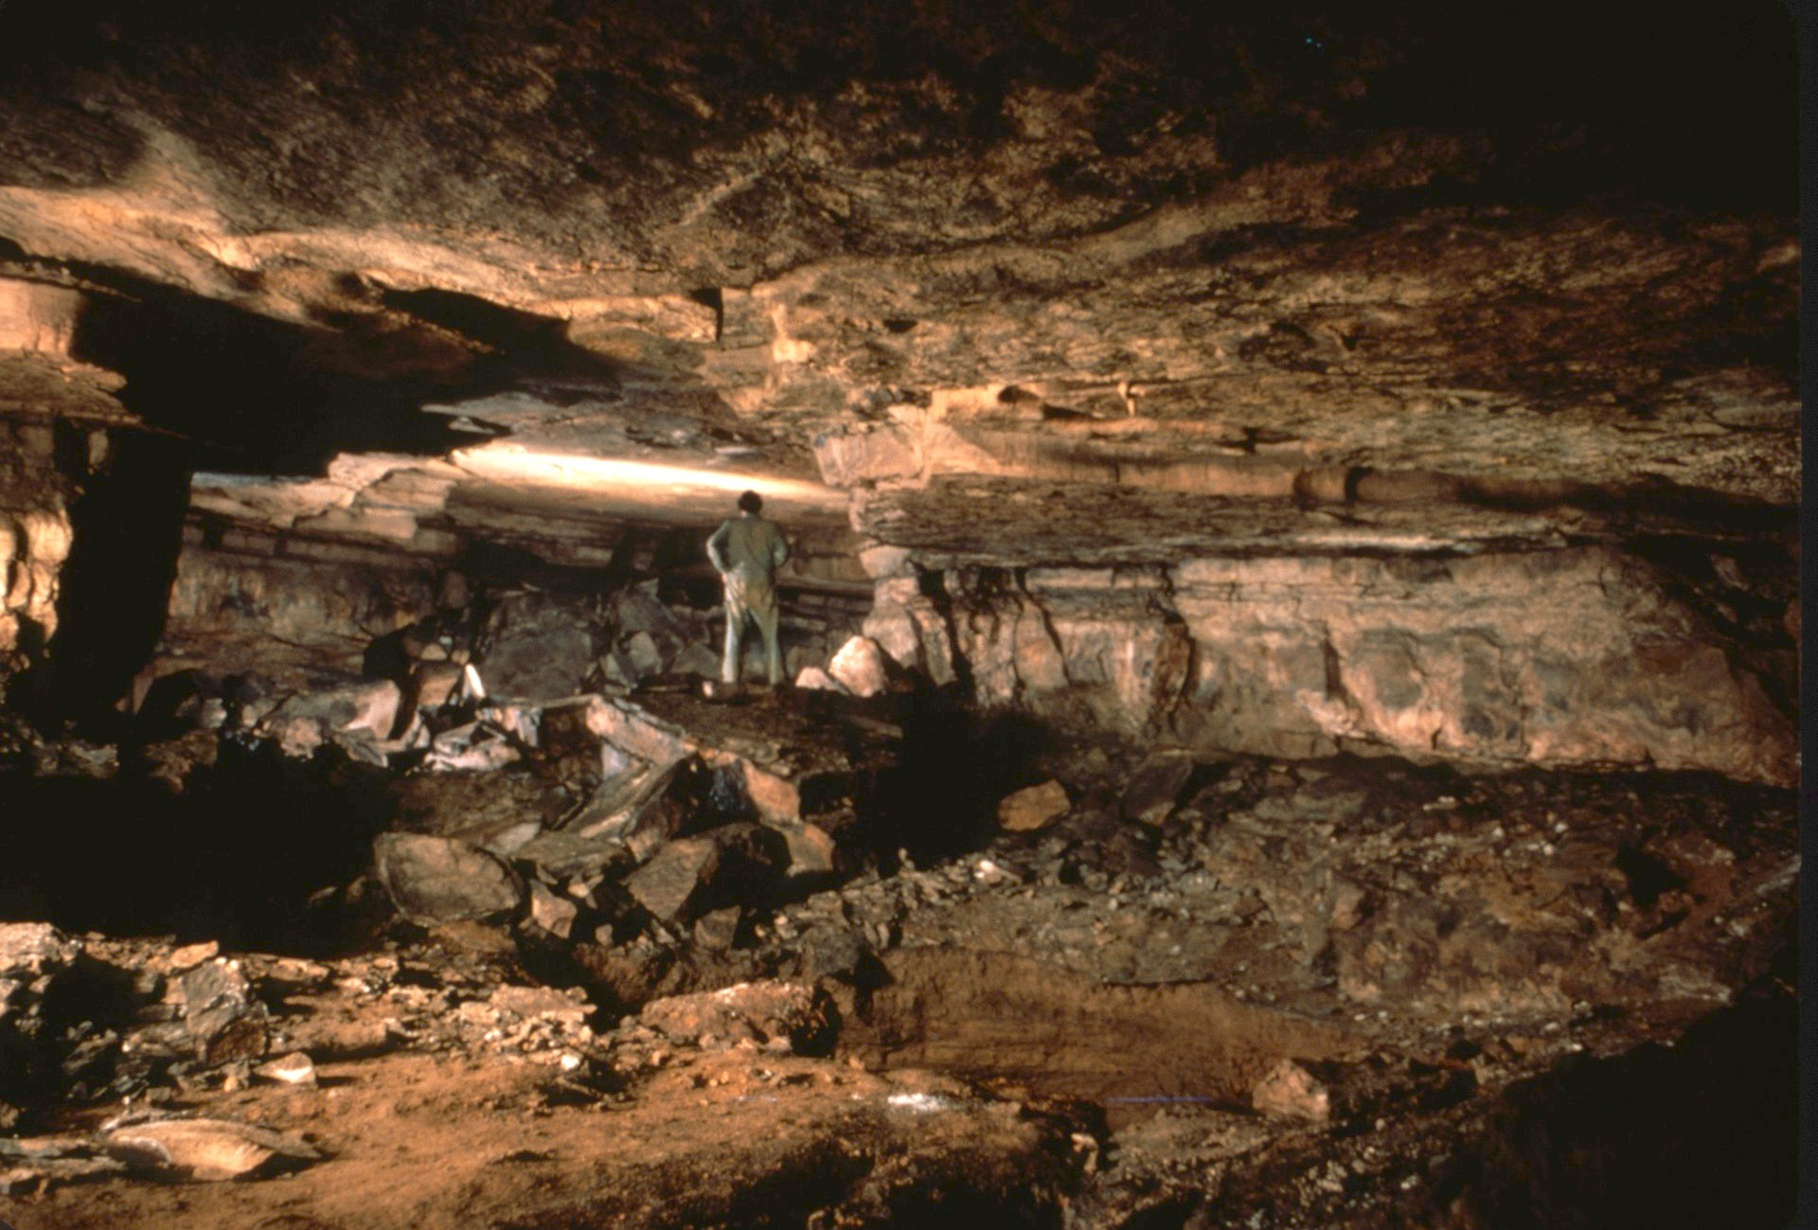

Slide 51
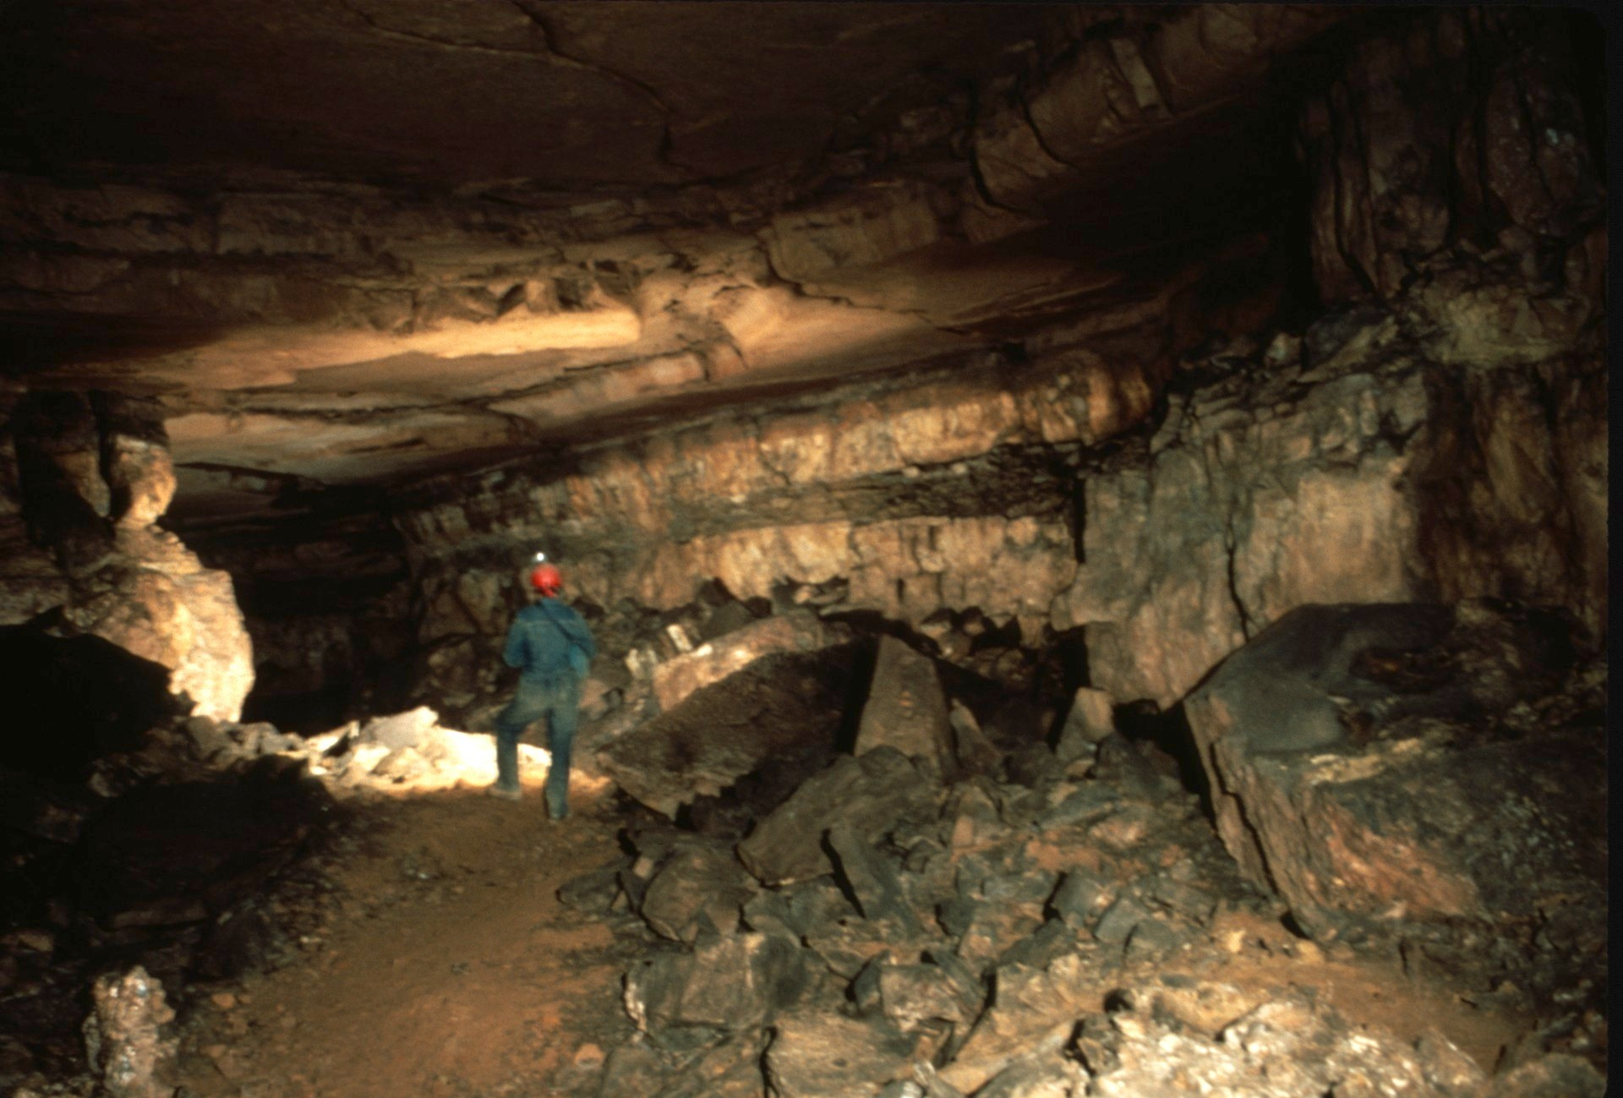

Slide 52
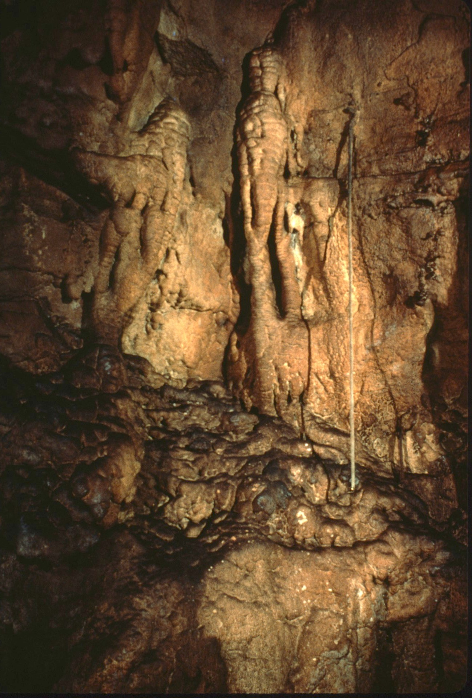
Notes:
A long soda straw decorates the wall.

Slide 53
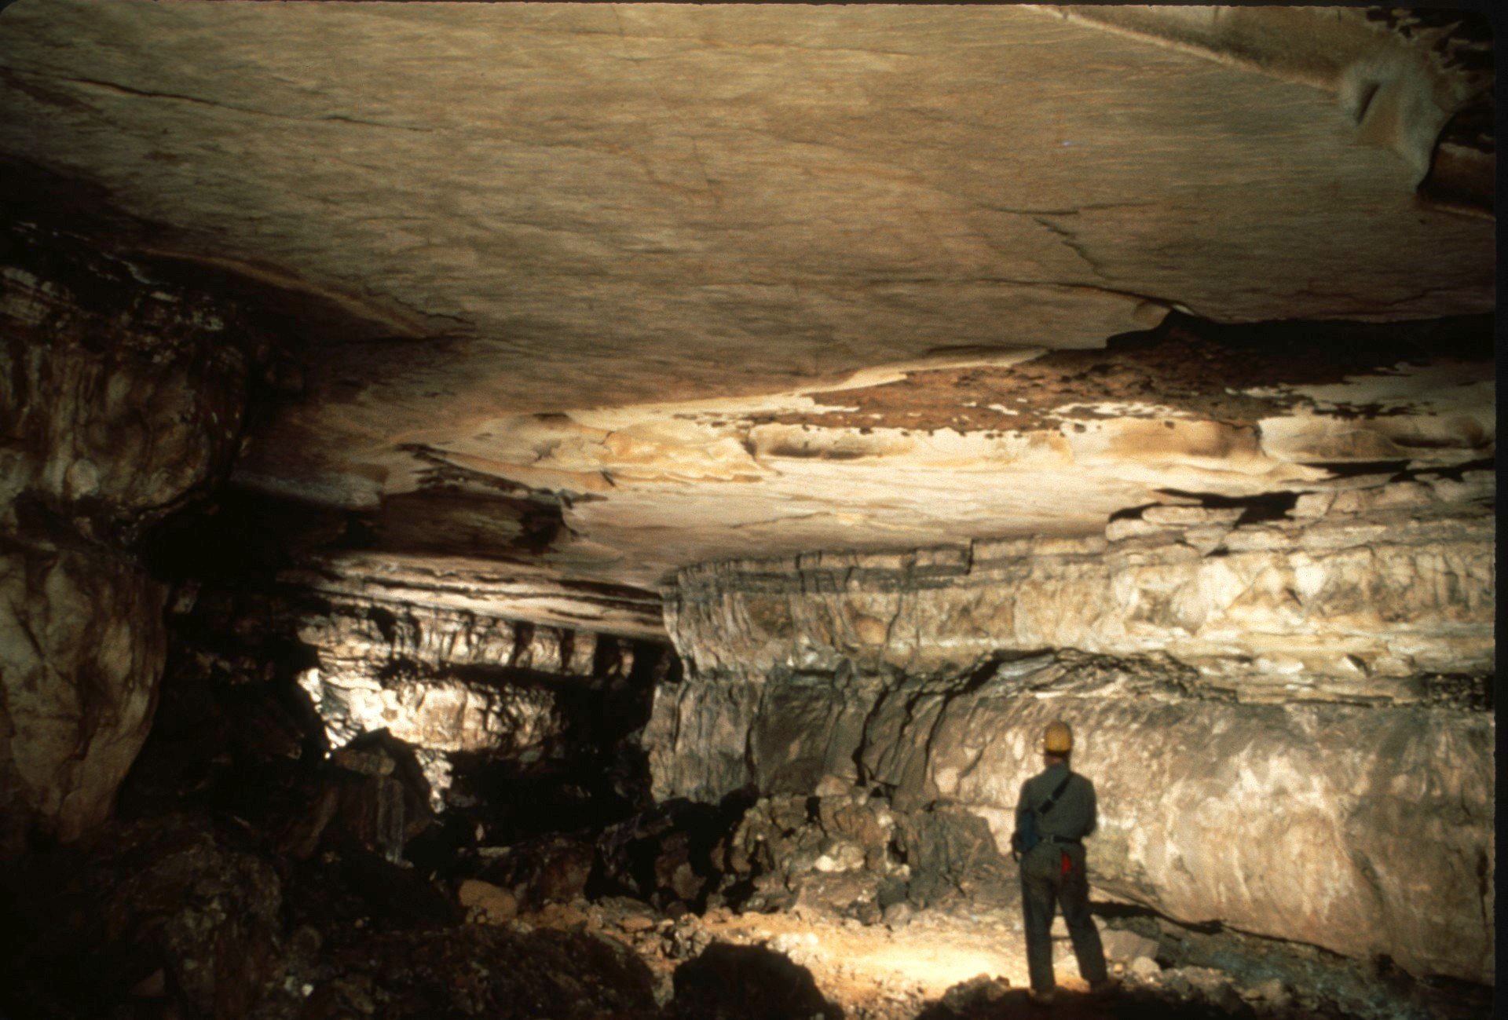
Notes:
The Left Hand Passage continues to…

Slide 54
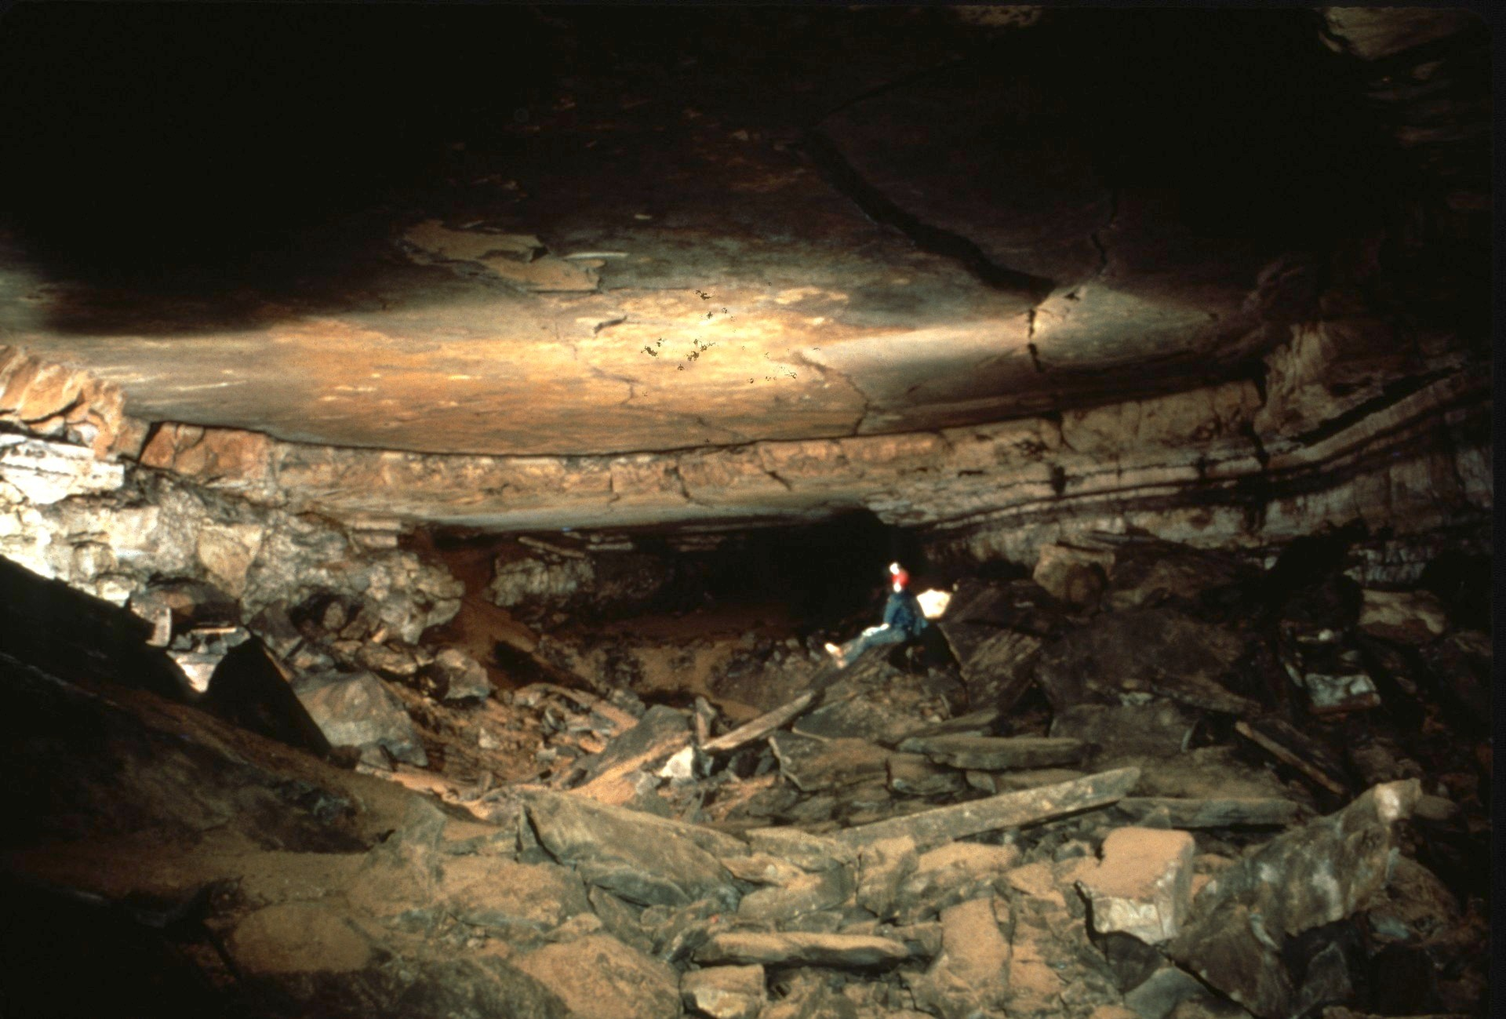
Notes:
the Handley Room.

Slide 55
Notes:
Climbing down a pit at one end of Handley Room, …

Slide 57
Notes:
…dropping through a squeeze…

Slide 58
Notes:
... opens to the continued descent …

Slide 59
Notes:
down Handley's Silo.

Slide 60
Notes:
Continuing along easy walking passage and by a column…

Slide 61
Notes:
the Sand Room cones into view.

Slide 62
Notes:
Leaving Sand Room going downstream in Upper Stream Passage leads to…

Slide 63
Notes:
the Throne Room and the Junction with "A" Trail, the route to the next lower level of passages. Before taking “A” Trail, …

Slide 64
Notes:
lets continue down Upper Stream Passage...

Slide 65
Notes:
to the waterfall Room, the largest room (150 foot long, 100 foot wide and 50 foot high) in the cave system.

Slide 66
Notes:
After returning to the Throne Room, ‘A’ Trail winds past ...

Slide 67
Notes:
several sections of gypsum hair which appear only in the winter.

Slide 68
Notes:
"A" Trail than combines with Discovery Passage, ...

Slide 69
Notes:
which proceeds to intersect the top of Organ Main Stream Passage.

Slide 70
Notes:
Organ Main Stream passage is one of the large breakdown littered stream passages typical of the Organ Cave System. Upstream from here is the tourist section of the cave.

Slide 72
Notes:
The tourist area of Organ Cave is noted for its collection of Salt Petre vats...

Slide 73
Notes:
... used during the American Civil War, …

Slide 74
Notes:
and the formations near the Rock Organ.

Slide 76
Notes:
In the entrance room...

Slide 77
Notes:
is a storage shed built by the federal government in the 1950s to hold survival supplied in the event of nuclear war.

Slide 78
Notes:
So ends our visit to Organ Cave.

Slide 80
Photography by Paul & Lee Stevens Waterfall Room picture George Dasher

Slide 81
An NSS Audio-Visual Library Presentation
Organ Cave, WV
Original slide program S739
Slides digitized by David Caudle
PowerPoint program created by Jim McConkey
81 slides, with script in presenter notes
PowerPoint created 12/08/2021
National Speleological Society
6001 Pulaski Pike
Huntsville, AL 35810-1122
256- 852-1300
nss@caves.org
https://caves.org/

